Slide 1
Python
James R. Bradley

Slide 2
Table of Contents
Python (Anaconda) Installation
Jupyter set-up
Introduction & Getting Started
Variables, Expressions, Statements
Boolean & Conditional Statements
Functions
Loops
Files: Reading & Writing
Data Structures: Lists
Data Structures: Dictionaries
Data Structures: Tuples

Slide 3
Table of Contents
Data Structures: Sets
More Sorting
Regular Expressions
numpy package
pandas package

Slide 4
Reference
Much of this course closely follows the topical sequence of this book:
Python for Informatics, by Charles Severance
This is a good book:
amazon.com: $9.95
Free from pythonlearn.com
Courier font indicates programming statements
Also included: numpy, pandas, sets

Slide 5
Python (Anaconda) Installation & Course Material Set-up

Slide 6
Course Material Set-Up
Get course materials here:
http://www.mason.wm.edu/programs/msba/mymsba/software_installation/
Compressed: http://bit.ly/2aePjES

Slide 7
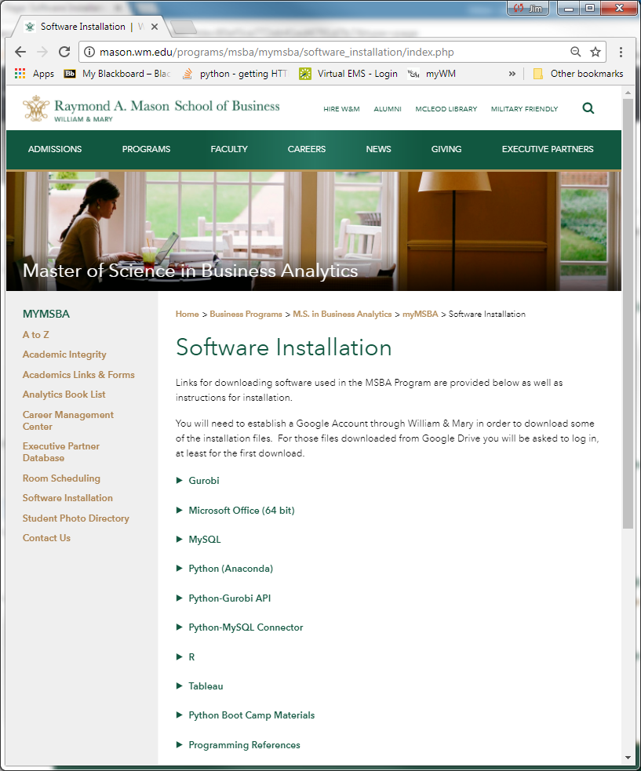
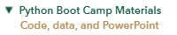
Course Material Set-Up

Slide 8
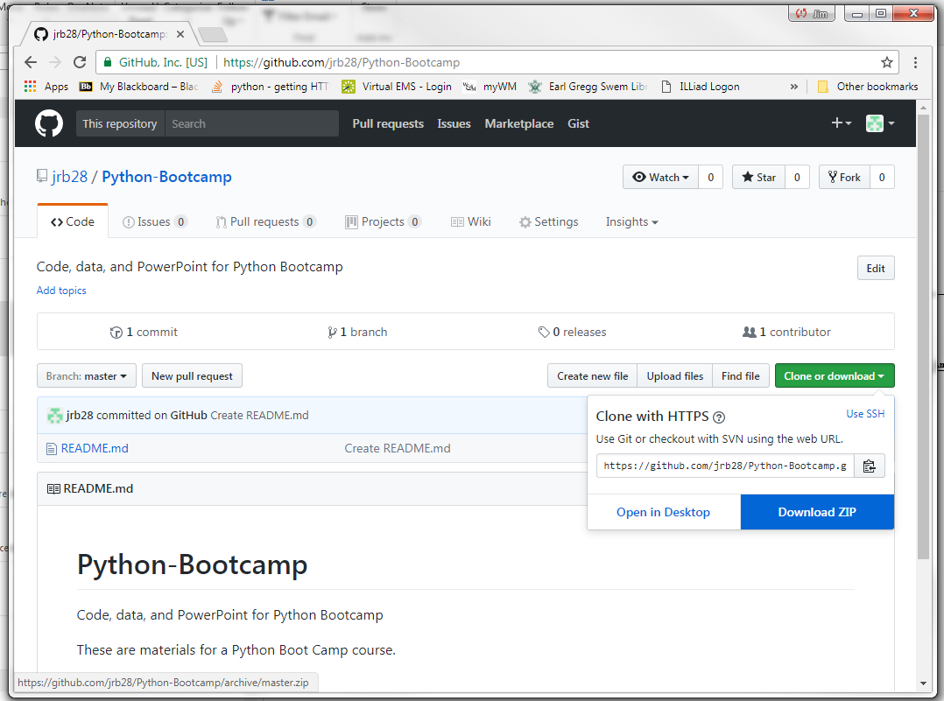
Course Material Set-Up
1
2

Slide 9
Course Material Set-Up
Pick a folder on your computer, your_root\, for course materials
Suggestion: C:\PythonBootCamp
Download the github zip file to that location
Extract the zip file into that folder
The download may or may not be a zip file
View the course materials folder at your_root\Python-Bootcamp-master
Also, create a folder entitled myCode in C:\PythonBootCamp for code you write

Slide 10
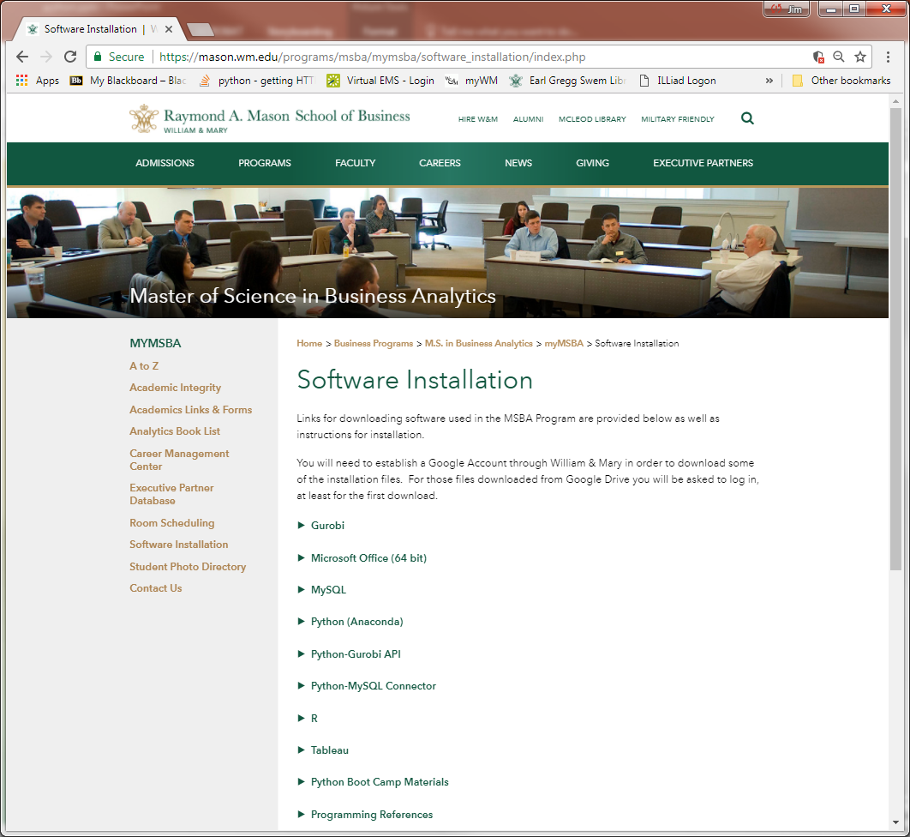
Python (Anaconda) Installation
MSBA software
www.mason.wm.edu/programs/msba/mymsba/software_installation
Click on the arrow

Slide 11
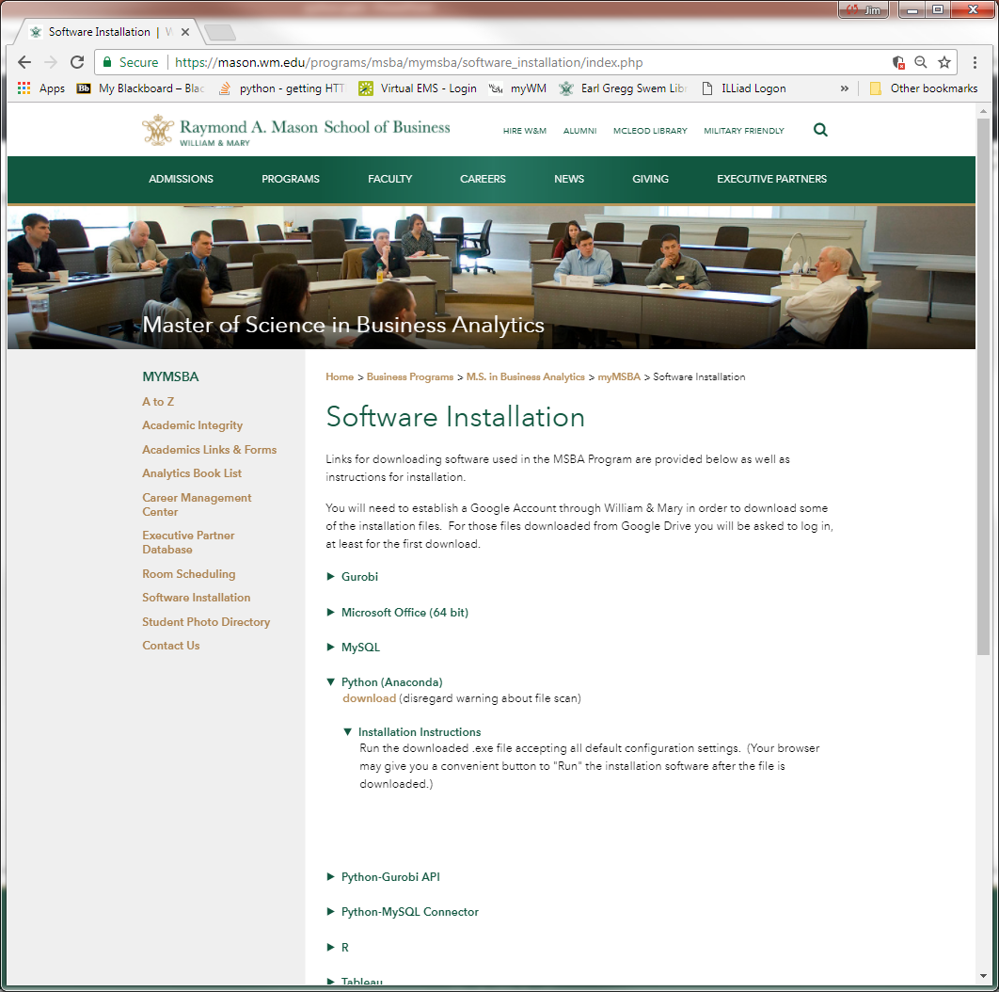
Python (Anaconda) Installation
Left click on “download link” and follow installation instructions

Slide 12
Anaconda
Why Anaconda Python?
Many packages already installed
A package is code giving Python more functionality
Two coding environments
Spyder
Script Editor and Console Window for immediate results
Efficient debugging
Breakpoints
Ideal for execution of “final” algorithms
Jupyter Notebook
Interactive data exploration
Prototype programs
Execute partial programs

Slide 13
Other Development Environments
IDLE
Atom
Visual Studio

Slide 14
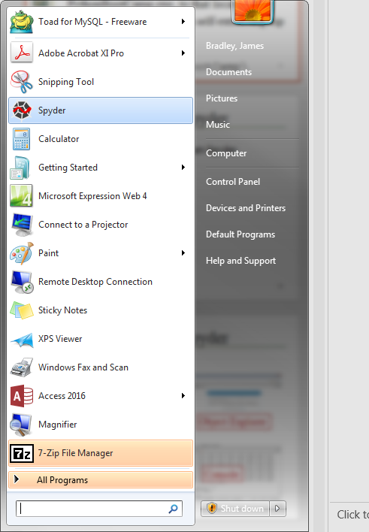
Anaconda Spyder
Start Anaconda Spyder from Start button

Slide 15
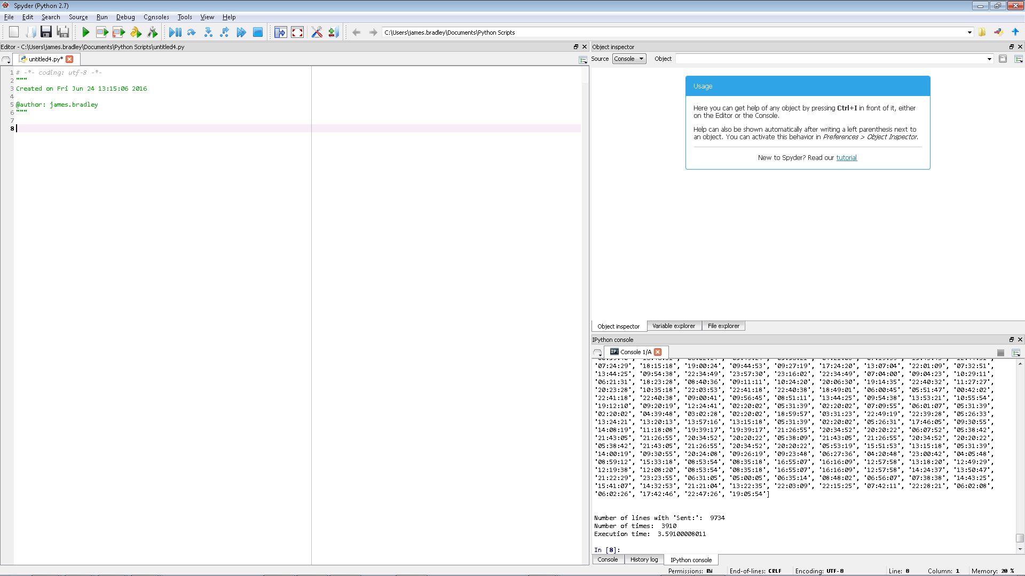
Anaconda Spyder
Start Anaconda Spyder
Object Explorer
Script Editor
Write many lines of code for sequential execution here
Console
Run 1 or a few lines of code here

Slide 16
Jupyter Notebook Set-up
What is Jupyter?
Multiple coding cells
Execute Python code, cell by cell
Good environment for
“Prototyping” code
Exploring data
Communicating analysis sequence, including graphs
Not good for running a large program
Start Jupyter
Go to Windows Start icon
Depending on your Windows version use the next two slides as a guide to start Jupyter
A command window opens momentarily first

Slide 17
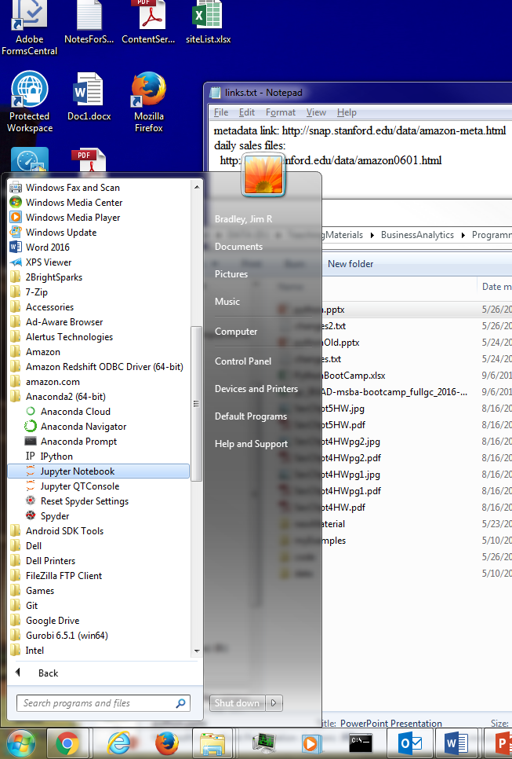
Jupyter Notebook Set-up
Windows 7

Slide 18
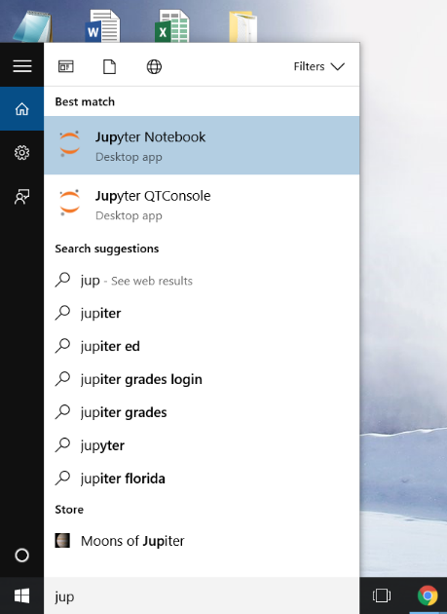
Jupyter Notebook Set-up
Windows 10

Slide 19
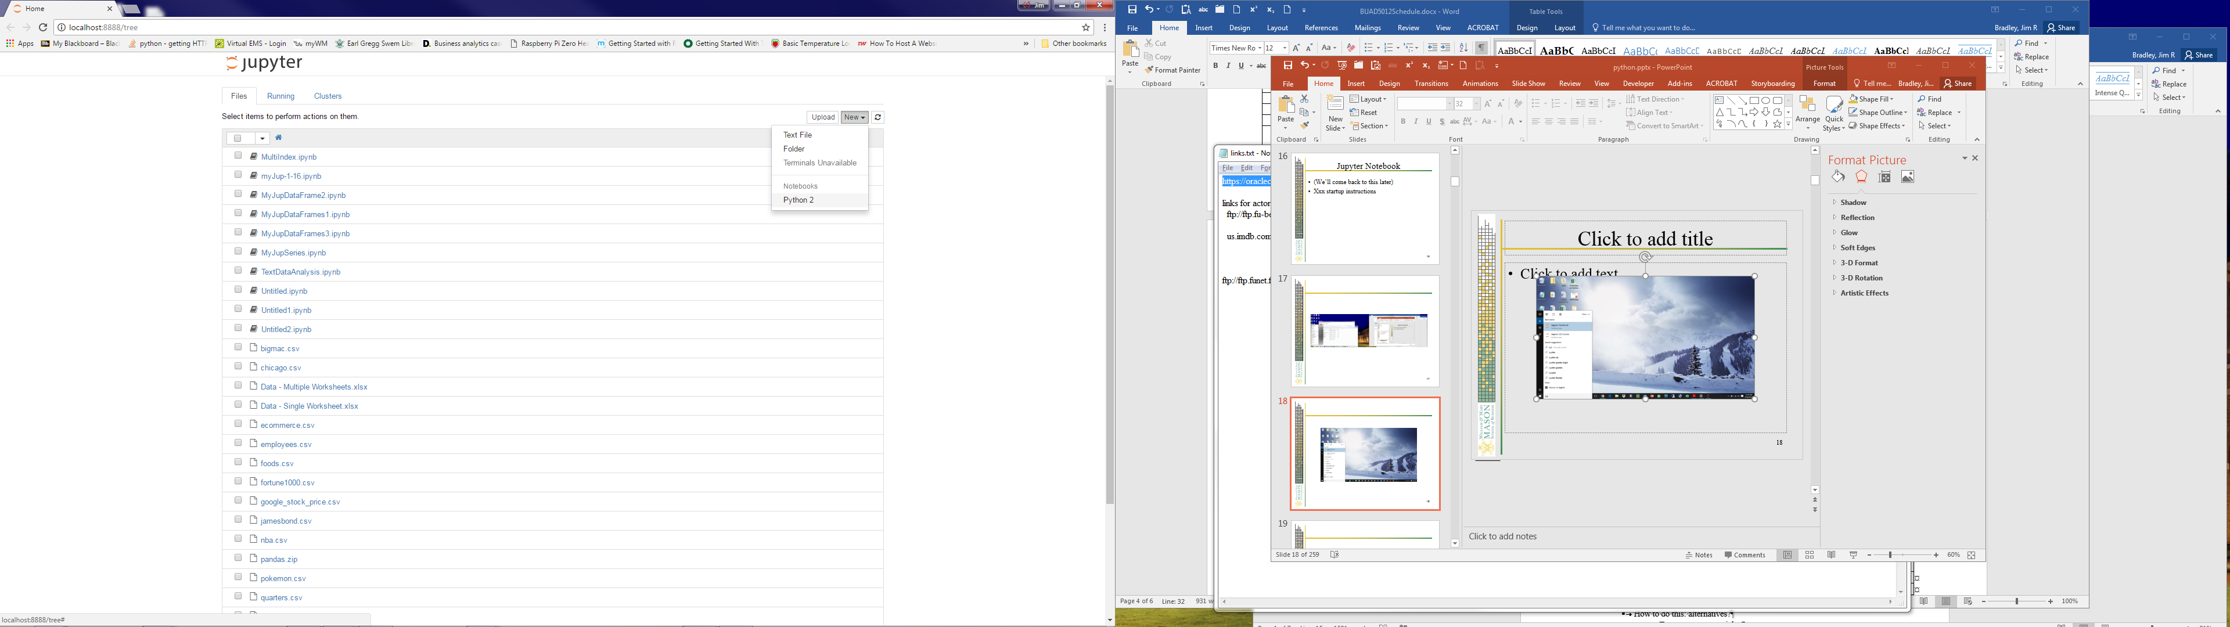
Jupyter Notebook Set-up
Open new notebook
Click on New
Choose Python 2
The 2 refers to Python 2.7 versus 3.4

Slide 20
Jupyter Notebook Set-up
Change default file folder—Method 1
Go to Start icon to view programs
Right click on Jupyter Notebook
Choose Properties
Change ‘Start in:’ entry
See also:
http://jupyter-notebook-beginner-guide.readthedocs.io/en/latest/execute.html#change-jupyter-notebook-startup-folder-windows
Method 2, in Anaconda Prompt Window:
jupyter notebook --notebook-dir ‘dir_path_here’
Restart Jupyter

Slide 21
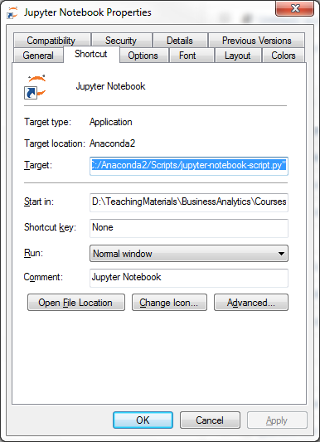
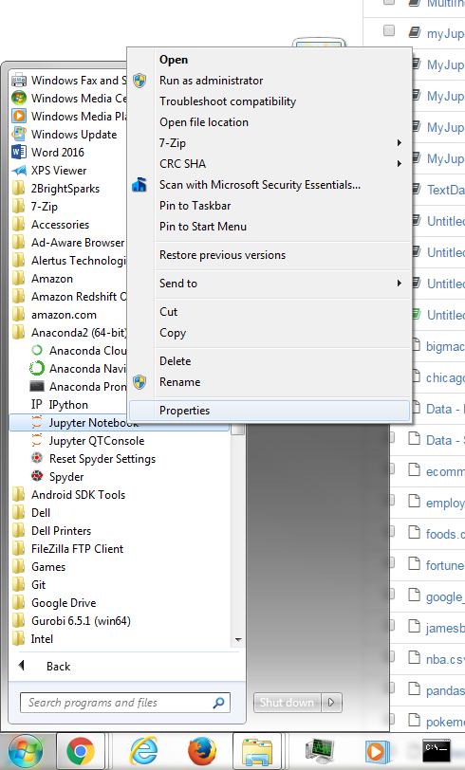
Jupyter Notebook Set-up

Slide 22
Jupyter Notebook Set-up
Ending Jupyter
Save your work in the notebook window
Go to the home browser screen
Click on Running tab
Click on Shutdown button for the notebooks you want to close
Find the Jupyter Notebook Command Window and type Ctrl+c

Slide 23
Jupyter Notebook Set-up
Ending Jupyter
Save the notebook
Go to the home browser screen
Click on Running tab
Click on Shutdown button for the notebooks you want to close
Find the Jupyter Notebook Command Window and type Ctrl+c

Slide 24
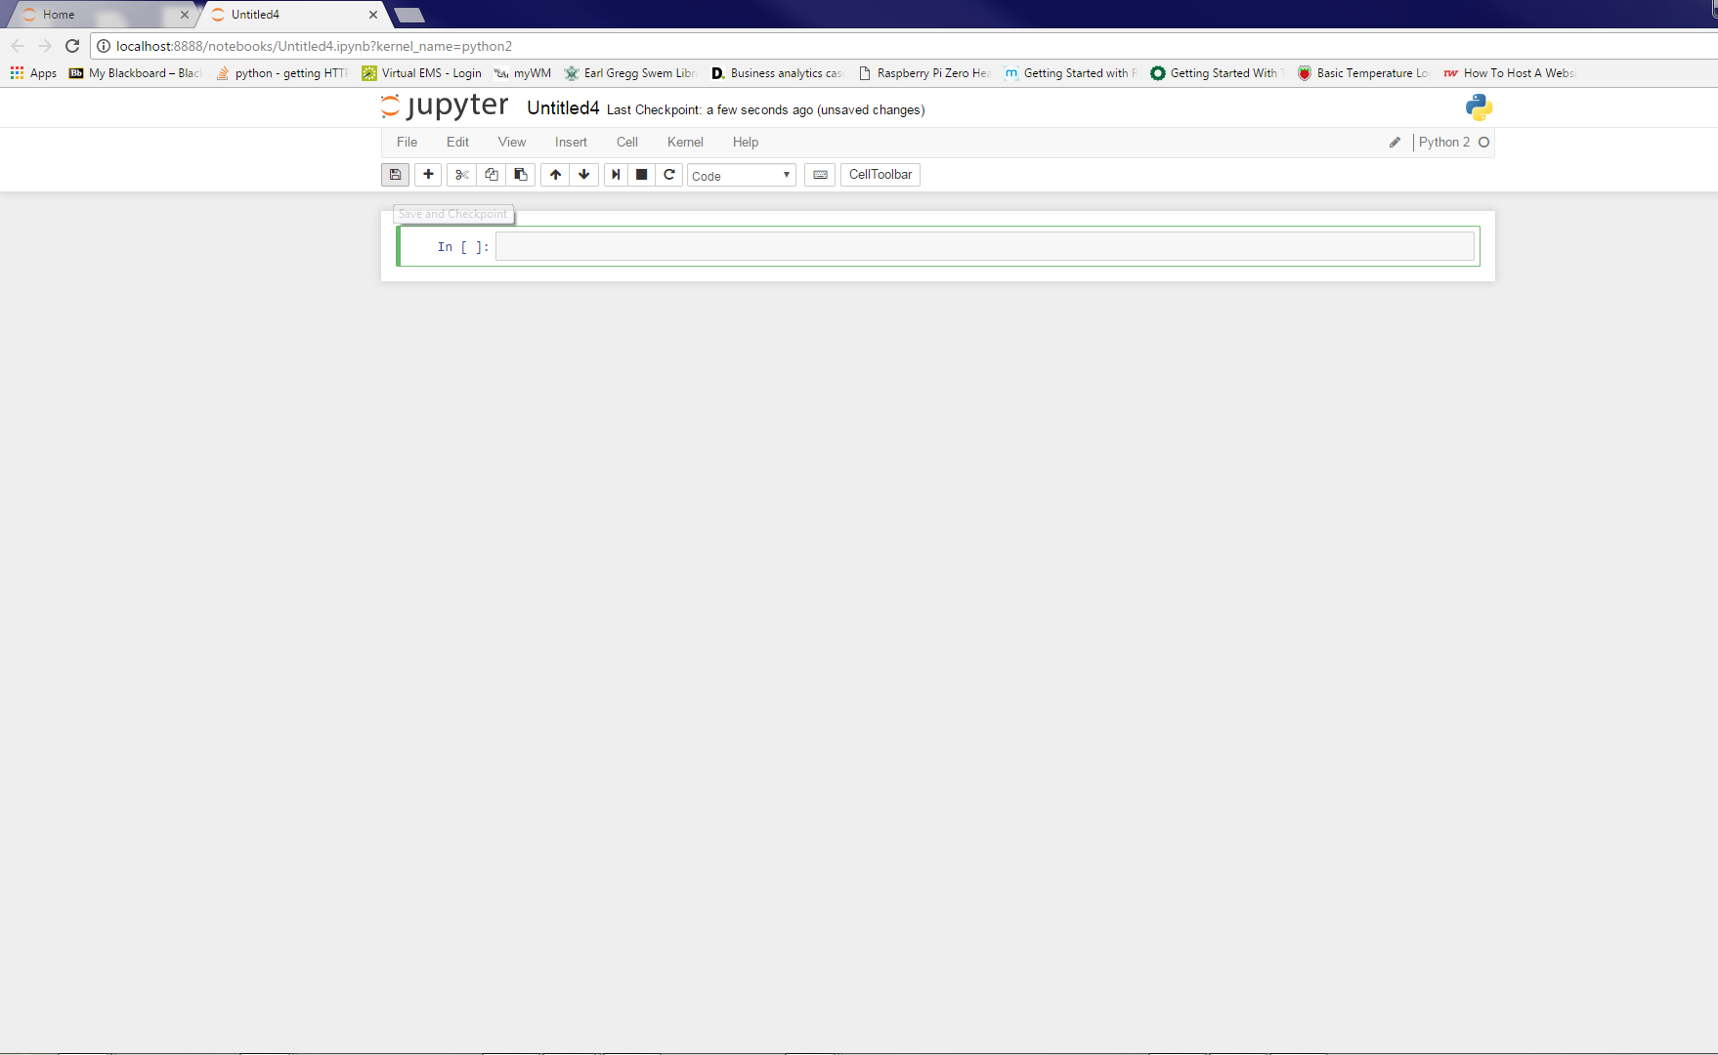
Jupyter Notebook Set-up
Save the notebook

Slide 25
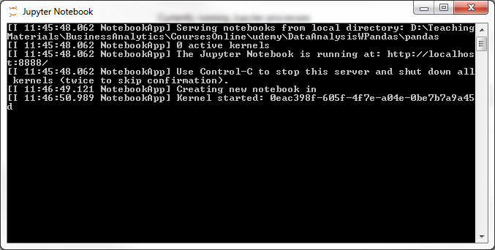
Jupyter Notebook Set-up
Type Ctrl-c to stop Jupyter server

Slide 26
Using Jupyter
Jupyter hot keys cliff notes
Ctrl+Shift+P: get list of hot keys
Or with menu: Help-Keyboard Shortcuts
Shift+Enter: execute current cell
Tab: code completion
Shift+Tab:
Typed after open parentheses shows method parameters
Esc+m: change cell to markdown
You must click on cell to enter markdown text
Shift+Enter: to execute markdown
Esc+F: find within input cells
Ctrl+a: select all
Ctrl+z: undo
Ctrl+c, Ctrl+v: copy and paste, as usual

Slide 27
Cheatsheets
From http://www.datasciencefree.com/cheatsheets.html
Look here:
your_root\PythonBootCamp\cheatsheets

Slide 28
Chapter 1 Introduction to Programming (Essential Version)

Slide 29
Computer Programming
This course is about programming
What is programming?
Notes:
What types of computer programming statements are used?
Math operations
Data input and output from files, Internet, etc.
Conditional statements: sometimes you need to execute a statement and sometime you don’t
Loops: for repetitive processing of statements
Operations on string data (text): searching, qualifying, concatenation, and extraction
Data conversion

Slide 30
Why Program… in Python?
For us, the first answer is obvious…. to do analytics
Makes it possible to automatically execute a set of steps
This is an algorithm
Data is most often:
Too large to inspect visually
Too large/slow to analyze with Excel, Minitab, …
Difficult to acquire and cleanse manually
Python can integrate the operation of many software packages…
MySQL, Gurobi (optimization), Tableau
Notes:
Also… Python is the most popular introductory programming language and it is often used in analytics

Slide 31
Why Python 2.7 versus 3.X
Python 2.7 is still the most prevalent version
Help is readily available online for 2.7
Package compatibility issues are rare

Slide 32
Simple Statements
Type these statements into the “Console” window (each followed by hitting “Enter”)
print "Hello World!"
print('Hello World!')
Print ('Hello World!')
x = 3
print x
print X
y = "Hello World!
x and y are called variables
Assignment statements (with “=” sign):
Right-side computed, then transferred to left-side variable

Slide 33
Caution: Copying ‘ and “
It is convenient to copy and paste text from this presentation into Spyder or Jupyter.
However, the single and double-quotes in PowerPoint are not the same as those in the Python editing environments
So, you will likely need to type over these characters after you have pasted into Spyder or Jupyter

Slide 34
Pointers
Commands and variables are case sensitive
Often you can use either quotation marks (") or apostrophes (') to indicate text/string data
print statements show results in Console window
Python lets you know when you type something it can’t understand
These are called syntax errors

Slide 35
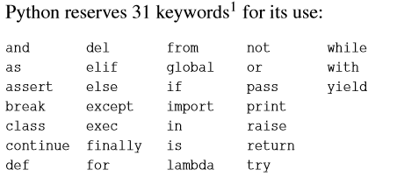
Keywords
You cannot use these keywords to name variables
There will be additional keywords in some cases depending on what packages you have loaded and how you have loaded them

Slide 36
Errors
Errors will happen
You will get faster in recognizing your errors
This is called debugging
Where did the term “debug” come from?*
We’ll show you methods to find errors
Sometimes errors do not result in error messages
With experience you will make each mistake less often and recognize and fix errors faster
* https://www.wired.com/2013/12/googles-doodle-honors-grace-hopper-and-entomology/

Slide 37
Debugging Resources
When debugging, Google it
But it takes experience to search effectively
Better search terms will give you the better results
Takes time to learn best search terms
Need instinct for knowing which advice is best
When you’ve found something likely to work
Which sites to trust
For example, what I’ve learned…
Give preference to stackoverflow.com
If you’ve Googled an issue for 2 hours either:
You’re not using the best search terms
Your problem is so rare that you need to reboot

Slide 38
Debugging Resources
Python reference site for version 2.7
https://docs.python.org/2/reference/

Slide 39
Error Types
Syntax Errors
print 'Hello World!
Print 'Hello World!'
Logic Errors
print 'Hello Wrld!'
x or y (but you really meant and)
Semantic Errors:
Computing an average
x1 = 7
x2 = 11
avg = x1 +x2/2

Slide 40
Chapter 1a Introduction to Programming (Extended Version)

Slide 41
Program Types
Interpreted programming languages
Computer translates each line of programming code, one at a time, into bit patterns interpretable by the CPU
Python is most-often used interpreted
… although it can be (somewhat) compiled (.pyc)
Compiled programming languages
Statements in programming code are converted to binary, machine language which are executed directly on the CPU (e.g., .exe)
All statements compiled before anything is run
Specific to particular processor types
32-bit Windows, 64-bit Windows

Slide 42
Program Language Types
Low-level versus higher level code
Lowest level
In binary code that is recognized by the CPU
Low level languages
E.g., assembler language
High-level
Code that relies on other lower level code
High-level code is replaced by the interpretation in lower-level language
Code faster
Code more closely resembles natural language
E.g., Python, Visual Basic

Slide 43
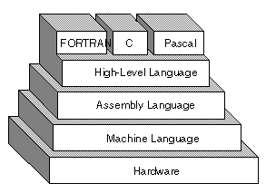
Program Language Types
High-level language
“… [a] strong abstraction from the details of the computer. In comparison to low-level programming languages, it may use natural language elements, be easier to use, or may automate (or even hide entirely) significant areas of computing systems (e.g. memory management), making the process of developing a program simpler and more understandable relative to a lower-level language.” (https://en.wikipedia.org/wiki/High-level_programming_language)
http://www.webopedia.com/TERM/H/high_level_language.html

Slide 44
Program Language Types
In Python
y = 2*x
In Assembly Language
Load x memory location into CPU register
Shift register left
Find y memory location
Write y to that location
http://www.webopedia.com/TERM/H/high_level_language.html

Slide 45
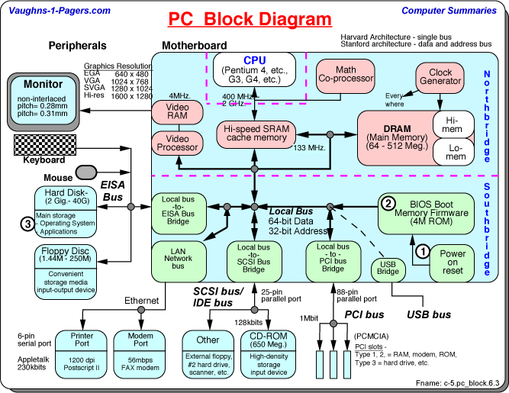
Computer Architecture
http://www.vaughns-1-pagers.com/computer/pc-block-diagram.htm

Slide 46
Chapter 2 Variables, Expressions, Statements & Operations

Slide 47

Basic Variable Types
Use Spyder Console Window or Jupyter
x = "hello"
type(x)
x = 'hello'
type(x)
x = 2
type(x)
x = 2.7128128459045
type(x)

Slide 48
Basic Variable Types
x = True
type(x)
x = true
type(x)
You must hit “Enter” (in Spyder) to execute a statement in the Console
I won’t show the key from now on

Slide 49
Basic Variable Types
str, string
float, floating point (with decimal)
int, integer (no fractional part)
bool, Boolean (True or False)
Python defines, and redefines a variable’s type depending on values you assign to it
Some errors are due to assigning data to a variable that is different than your intention

Slide 50
Basic Variable Types
Other, less common types:
Our familiar Base 10
oct, octal
base 8, largest digit is 7
e.g., 0357 = 239
bin, binary
base 2, largest digit is 1
e.g., 1011 = 11
long, long integer
Largest value for int is 2,147,483,647
Larger int values automatically converted to long
Don’t worry about this: int and long are interchangeable
1000 | 100 | 10 | 1
512 | 64 | 8 | 1
0 | 3 | 5 | 7
8 | 4 | 2 | 1
1 | 0 | 1 | 1

Slide 51
Basic Variable Types
Check out in Console
x = 8.0
print x, type(x)
x = int(x)
print x, type(x)
x = bin(x)
print x, type(x)
x = int(x,2)
print x, type(x)
x = float(x)
print x, type(x)
The argument 2 in x = int(x,2) denotes the base of the input
Notes:
Transforming to binary can’t be done with float values
The resulting binary string is of the string type

Slide 52
Basic Operations
Operation | Symbol | Example | Notes
Addition | + | 1 + 2 | For numerical arguments
Subtraction | - | 9 - 4
Multiplication | * | 2×3 = 2*3
Division | / | 10/2
Concatenation | + | "Go" + " Tribe" | For string arguments
Exponentiation | ** | 2³ = 2**3
Modulus | % | 9%2 = 1
Modulus is the “remainder operator”
The remainder after the second argument is divided into the first operator as many (integer) times as is possible

Slide 53
Operations & Variable Types
Check out in Console window:
x = 2
y = 3
print y/x
Is this what you would expect?

Slide 54
Operations & Variable Types
Try previous code with a minor change:
x = 2.0
y = 3
print y/x
What happened?

Slide 55
Operations & Variable Types
Or try this:
x = 2
y = 3
print y/float(x)
What happened?

Slide 56
Operations & Variable Types
If all data in a operation (+, -, *, /, **,%) are of integer type, then Python truncates the result to an integer value

Slide 57
Basic Operations
Modulus operator example…
A distribution center loads 53-foot trailers each of which can hold 800 cases. The day’s schedule calls for 4,150 cases to be packed for a particular destination.
How many full trailers will be shipped?
How many units will remain to be shipped the next day?

Slide 58
Operations & Variable Types
Let’s checkout these operations:
Exponentiation
Numbers with exponents
What is the compounded interest results from an annual interest rate of 7% over 10 years?
Concatenation
Concatenate these two strings:
Hello
World!

Slide 59
Order of Operations
Fixed cost of a cell tower installation:
cost_fixed = 500000
Variable equip. cost per 100 calls (capacity):
cost_p_100 = 50000
Compute installation cost of 700-call tower:
cap = 700
Does this give the correct answer? Why?
cost_total = cost_fixed + cap * cost_p_100 / 100

Slide 60
Order of Operations
Compute the average of two numbers
Does this give the correct answer? Why?
x1 = 7
x2 = 11
avg = x1 + x2/2

Slide 61
Order of Operations
Compute the average of two numbers
Does this give the correct answer? Why?
x1 = 7
x2 = 11
avg = (x1 + x2)/2
print avg

Slide 62
Order of Operations
Computations are made in this order, from left to right:
Parenthetical operations
Exponentiation
Multiplication/Division
Addition/Subtraction
Everything within parentheses is computed before lower-level parenthetical statements and non-parenthetical operations

Slide 63
Script/Program
Let’s put these in the Script Editor window in Spyder and run altogether:
x1 = 7
x2 = 11
avg = (x1 + x2)/2
print avg
Then, we can save the file to this folder:
your_root\PythonBootCamp\myCode
…with filename 2-1my.py

Slide 64
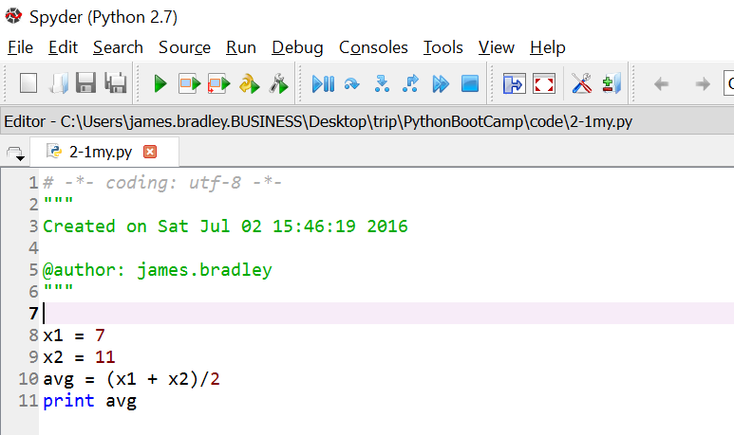
Script/Program
Run the program by clicking on the green triangle as shown below or click on F5

Slide 65
Order of Operations
What values are assigned to x?
x = 1+10/2*5
x = 1+10/(2*5)
What is the result here:
(3+(4)**2*3+(28/7*2)/2*2)
Compute manually, verify with Spyder

Slide 66
Naming Variables
What happens when you type this into the Console Window?
fixed overhead = 37
Variables cannot have spaces!!!
This is a syntax error
Which variable name is preferable?
x123 = 37
fixed_overhead_rate = 37
fixed_oh_rate = 37

Slide 67
Naming Variables
Naming advice
Use mnemonic names, but short as possible
Underscores
var_cost = 10
… or camel case
varCost = 10

Slide 68
Naming Variables
Type this into the Console Window
varCost = 10
What do these statements do?
print varcost
print varCost

Slide 69
Built-in Python Functions
Maximum (max) and minimum (min) functions:
x = 1
y = 9
print min(x,y)
print max(x,y)

Slide 70
Additional Math Functions
This statement “loads” a package (bunch of code) that defines new math functions:
import math
Examples
math.pow(x,y)
x^{y}
math.log(x)
natural logarithm
math exp(x)
e^{x}
math.log10()
base 10 logarithm
math.sqrt()
square root
math.fabs()
absolute value

Slide 71
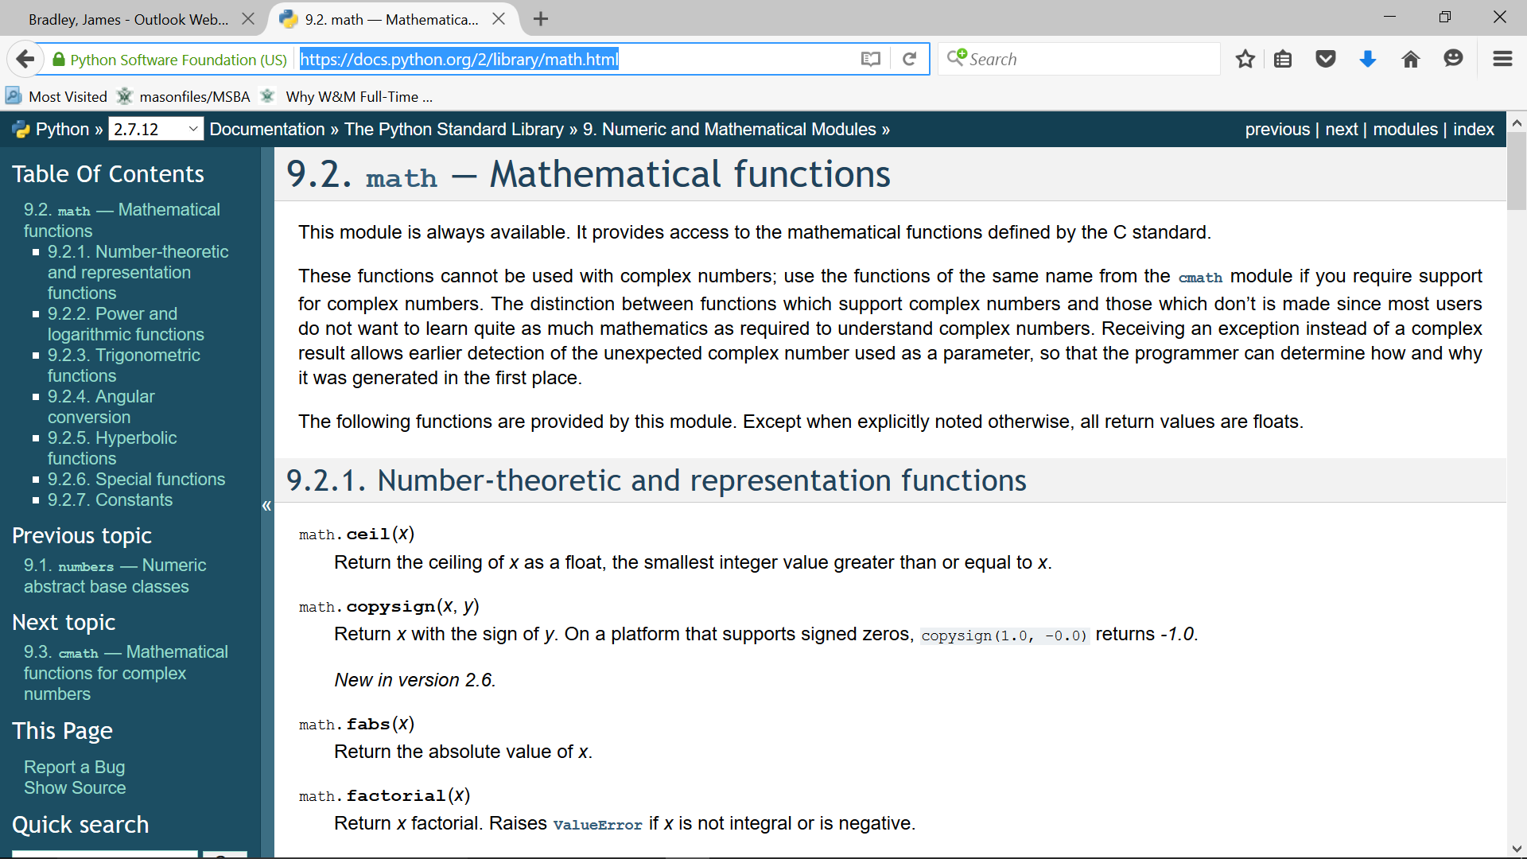
Additional Math Functions
Look here to see all the functions:
https://docs.python.org/2/library/math.html

Slide 72
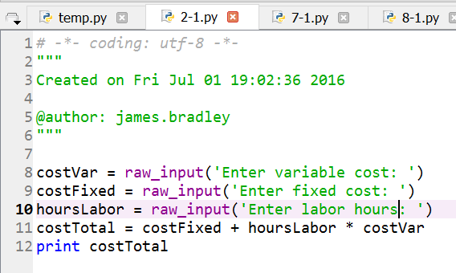
Keyboard Input
Get keyboard input: raw_input(prompt_string)
Available in 2-1.py
Type it and run it
costVar = raw_input('Enter variable cost: ')
costFixed = raw_input('Enter fixed cost: ')
hoursLabor = raw_input('Enter labor hours: ')
costTotal = costFixed + hoursLabor * costVar
print costTotal

Slide 73
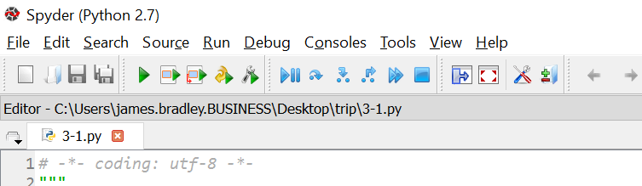
Interlude
Let’s talk about debugging
Break points
Using the terminal window/console to debug
Start running, stop at first breakpoint
Execute one line of code
Execute until next breakpoint
Stop
Notes:
Breakpoints may be defined in the Editor.
Simple breakpoints can be set from the Run menu, by keyboard shortcut (F12 by default), or by double-click to the left of line numbers in the Editor.
Conditional breakpoints can also be set from the Run menu, by keyboard shortcut (Shift+F12 by default), or by Shift+double-click to the left of line numbers in the Editor.
Can’t set from Run menu in Spyder 2.7

Slide 74
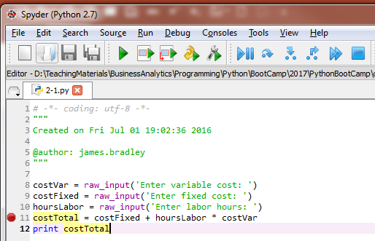
Debugging
Breakpoints
Double-click on gray area left of row numbers
Program execution stops before these steps are executed

Slide 75
Debugging
Breakpoints
Values of variable can be assessed in the Console Window when execution is paused at a breakpoint
Print statements are often used in debugging

Slide 76
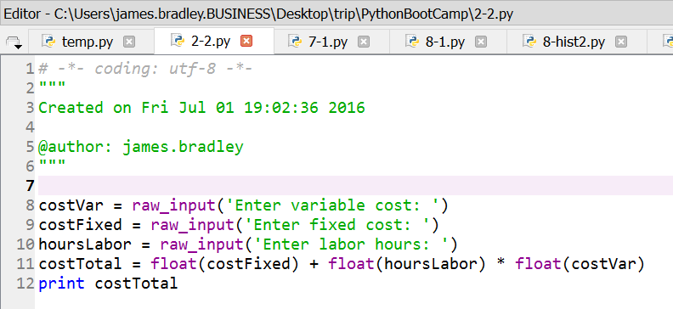
Keyboard Input
raw_input()yields string data
Try again using conversion to float: float()
Available in 2-2.py

Slide 77
Interlude
Commenting your code
# comments out remainder of a line
""" comments out all lines until next instance of """
Commenting code is important
You will soon forget the details of what you did and how you did it
Give yourself, and whomever may use your code, a chance of understanding how it is constructed

Slide 78
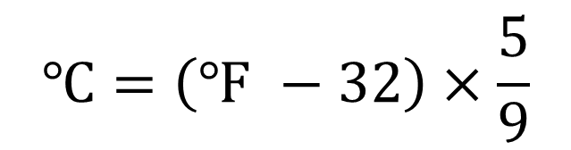
In-Class Exercise
Write script in the Editor window to convert a Farenheit temperature entered via raw_input()into a Celsius temperature and print out the result in the Console window
Save script in your_root\PythonBootCamp\myCode with filename 2-2my.py
$$℃=\left(℉ −32\right)×\frac{5}{9}$$

Slide 79
Homework
Exercise 2.3, pg. 30
Exercise 2.4, pg. 30
Exercise 2.5, pg. 30
We’ve already done this as an in-class exercise

Slide 80
Chapter 3 Boolean and Conditional Statements

Slide 81
Boolean Statements
Boolean statements are either True or False
Type these lines into the console window:
x = 3
print x == 3
print x == 4
Notice the double equals signs… try this
print x=3
= is for assignment
== is a logical (True or False) comparison

Slide 82
Boolean Statements
Boolean variables are either True or False
Type these lines into the console window:
x = 3
y = x == 3
print y
z = x == 4
print z
y and z are Boolean variables

Slide 83
Boolean Statements
Boolean Comparison | Description
== | Tests whether two variables have the same value
!= or <> | Not equal to
> | Greater than
>= | Greater than or equal to
< | Less than
<= | Less than or equal to
is | Test where two variables are the same object (i.e., same data type, same position in memory, same value)

Slide 84
Boolean Statements
Examples
x = 4
y = 5
print x == y
print x < y
print x > y
x = 3
y = 3.0
print type(x)
print type(y)
print x == y
print x is y
Notes:
Test z1 = [1,2], z2 = [1,2] with is operator

Slide 85
Boolean Statements
Boolean Operators | Meaning
not | Negates Boolean statement
and | Tests whether both Boolean statements are true
or | Tests whether one or both of two Boolean statements are true
x = 4
y = 5
print x==y
print not(x==y)
print
print x<y
print not(x<y)
print (x<5) and (y>5)
print (x<4) or (y>5)

Slide 86
Conditional Statements
Pick at most one code block to execute depending on situation
If-Then-Else statements rely on Boolean expressions
if Boolean_stmt_1:
execute if Boolean_stmt_1 True
elif Boolean_stmt_2:
execute if Boolean_stmt_2 True
else:
execute in all other cases

Slide 87
Conditional Statements
Structure
if, required
elif, optional
Contraction of “else if”
Code block executed if previous code blocks are not executed and condition is true
Can be multiple elifs
else, optional
Code block executed if none before are
Don’t forget colons
Indents for “code blocks” required
Also for readability

Slide 88
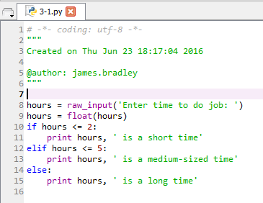
Conditional Statements
Example (3-1.py)

Slide 89
In-Class Exercise
Write script that:
Accepts an integer as input via raw_input()
Determines whether the number is odd or even and prints out the (1) the number and (2) either “odd” or “even” as is appropriate
Save as 3-1my.py

Slide 90
Conditional Statements
When there is a chance a statement will cause (throw) an error, use Try-Except:
Will this code always work?

Slide 91
Conditional Statements
Hint. Try this in the Console window:
float('text')

Slide 92
Conditional Statements
try:
do_something_here
except:
code block runs upon error

Slide 93
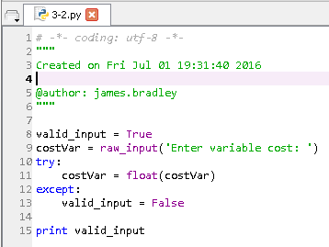
Conditional Statements
Let’s fix the 2-2.py code for one variable
Available in 3-2.py

Slide 94
Conditional Statements
Putting it together: insert the try-except block 3 times in this original code

Slide 95
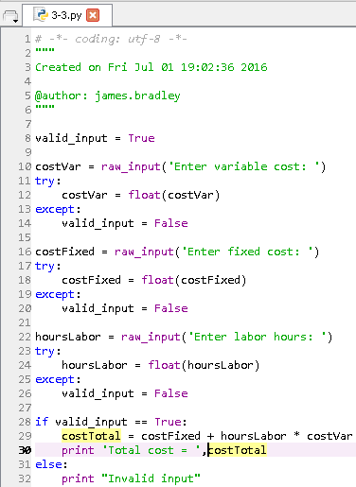
Conditional Statements
Fix the “type” or “shape” problem
Three (identical) blocks of code to convert string data to floating point data, if possible
How does this code work?
Save this as 3-2my.py
Already available as 3-3.py

Slide 96
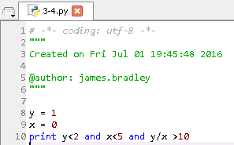
Conditional Statements
Try this (3-4.py)
Guardian Pattern
After evaluation of each term in a Boolean statement the evaluation of the statement is halted if it is clear it will be false
y = 1
x = 0
print y<2 and x<5 and y/x >10
y = 1
x = 0
print y<2 and x!=0 and x<5 and y/x >10

Slide 97
In-Class Exercise
Implement the Fahrenheit-Celsius conversion using try-except to screen for acceptable input data

Slide 98
Typical Errors
Case sensitivity
Not typing variable names or functions using the proper case
Indentation errors
Not indenting code under if-else blocks, try-catch structures
Not having proper or consistent indentation under if-else, try-catch structures
Not starting lines on first space
4 space indents between levels is typical

Slide 99
Homework
Exercises 3.1 – 3.3, pp. 40-41

Slide 100
Chapter 4 Functions

Slide 101
Functions
We’ve already used (built-in) functions:
max(), min(), str(), int(), float()
Syntax/terminology
In this statement, str(4):
“str” is the function
4 is the argument
In this statement min(2,3):
“min” is the function
2 & 3 are the arguments

Slide 102
Functions
For list of built-in Python functions:
https://docs.python.org/2/library/functions.html
Includes these that we will use:
range(): create a list of numbers
len(): compute the length of data
abs(): absolute value
pow(): one number raised to the power of another
sum(): sum of numbers
open(): open a data file for input

Slide 103
Custom Functions
We can also write our own custom functions
We’ll show an example that demonstrates how to write a function and why you would want to do it

Slide 104
Custom Functions
Remember 3-3.py?
Let’s make it succinct using custom functions

Slide 105
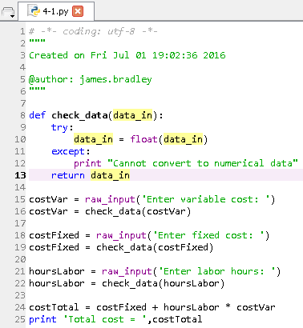
Custom Functions
A custom function to convert string data to float data
Function declaration
Passed parameter
Indentation
Return statement

Slide 106
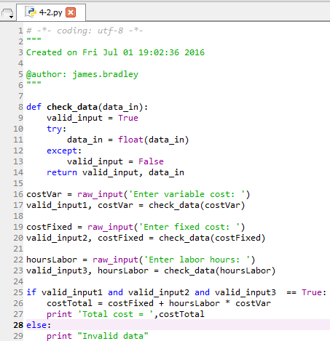
Custom Functions
A further improvement
Function declaration
Return two parameters

Slide 107
Custom Functions
Benefits of functions:
Only one instance of code to maintain
Less time to revise
Fewer errors because you don’t miss revising an instance
Clearer code, more understandable
Shorter code
Provides for code reuse
Saves time writing code later
Functions are easily reused
… digging lines here and there out of a program takes longer and is fraught with error

Slide 108
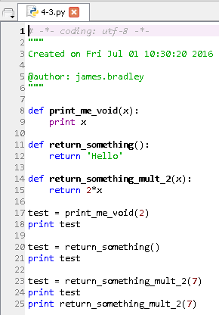
Back to Functions
Some functions return values, some do not
“Fruitful” (Severance) versus void functions
See 4-3.py

Slide 109
In-Class Exercise
Write a custom function that receives one argument, temperature on the Fahrenheit scale, and returns temperature on the Celsius scale
Use the code you’ve written before

Slide 110
Youtube Video
Another explanation of basic functions:
https://www.youtube.com/watch?v=Lhno4T53vcg&t=1s&index=5&list=PLxYh7ZSzU5052ugdqSbsVvfqU1jQVOJTI

Slide 111
Homework & In-class Exercises
Exercises 4.4 – 4.7 pp. 54-55

Slide 112
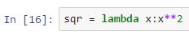
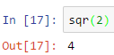
Lambda Functions
Lambda functions are a “short cut” for specifying simple functions
Create a named function syntax
Using the lambda function
Name of function
Dummy variable for input
How the lambda function transforms the input

Slide 113
Homework
Create a lambda function that computes the cost of cell tower construction
The argument passed to the lambda function is the number of calls capacity for the tower
The fixed construction cost is $50,000
The variable cost per call is $5,000
Test the lambda function in some code

Slide 114
Homework
Write a program, using a lambda function, to compute the Euclidean distance between two 2-dimensional points.

Slide 115
Homework & In-class Exercise
lambda functions can take multiple arguments
This problem requires you to experiment or do a Google search
Create a lambda function that, taking two arguments, returns the maximum of the two
Test the lambda function in some code

Slide 116
External Functions
Code that is imported such as we have done with import math are called packages
Many packages already installed in Anaconda
You can write a package…
To reuse code

Slide 117
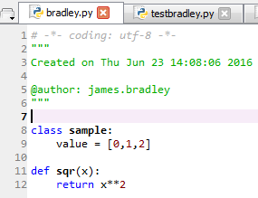
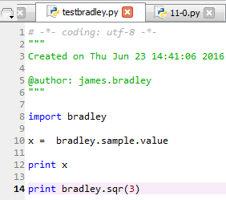
External Functions
For example, let’s
bradley.py is in the code distribution
Put in the same folder as a Python program, then
import bradley
from bradley import *

Slide 118
Chapter 5 Loops

Slide 119
Loops
The power of the computer is the rapidly repeated execution of programming code
Loops are a key tool in this regard
Two scenarios. Execute a code block:
For a known number of times
Use a ‘for’ loop
For an unknown number of times
Until some criterion is satisfied
Use a ‘while’ loop

Slide 120
Loops
for-loop Structure
Known number of iterations through loop
[0, 1, 2] is a list
We’ll discuss this more later
for i in [0, 1, 2]:
print i
Performs the indented steps 3 times with, sequentially, i=0, i=1, i=2

Slide 121
Loops
Built in range(x)function
This function creates a ‘list’ of integers based on the value x
x must be an integer
The list will contain x integers 0 through x–1: [0,…,x-1]
Try this in the Console Window:
print range(3)
This code does the same as the previous code:
for i in range(3):
print i

Slide 122
Lists
Another version of range() function
range(i,j) creates a list with integer elements starting at i and ending with j-1
In-class Exercise
In the Console window print out integers starting as 9 and ending with 18

Slide 123
Loops
Still another version of range()
range(start,stop[,step])
Creates a ‘list’ of numbers which:
Starts at the value start
Default start = 0
[] means step is optional argument
Default step is 1
Ends at the greatest possible value such that start + n×step that is less than stop
https://docs.python.org/2/library/functions.html#range
start/stop/step must be integers

Slide 124
In-Class Exercise
Use only the range(start,stop[,step]) function to create a list of even numbers starting at 2 and ending with 20.

Slide 125
In-Class Exercise
Compute the sum of the first 10 terms of this summation using a for loop:
1 + x + x² + x³ + x⁴ +…
… for any value 0.0 < x < 1.0
Let’s try x = 0.5
Input x with raw_input()function

Slide 126
Loops
Typical while loop code
This is a silly example for a while loop, but it helps us get to the next stage
Loop keeps iterating as long as this Boolean statement is True
keep_going = True
i = 0
while keep_going == True:
i = i + 1
if i >= 19:
keep_going = False

Slide 127
In-Class Exercise
Use the loop structure on the previous slide
Use a while loop to compute the series
1 + x + x² + x³ + x⁴ +…
… for any value 0.0 < x < 1.0
Keep adding additional terms while the incremental terms are greater than 10⁻⁸
Input x with raw_input() function

Slide 128
Machine Precision
Computers (most often) do not represent numerical values exactly because
Computers represent numbers in binary format
Base 2, 0s and 1s
Computers store limited decimal places
Base 10
1000 | 100 | 10 | 1 |  | 1/10 | 1/100 | 1/1000 | 1/10000 | 1/100000 | 1/1000000
 |  |  |  | .
Base 2 (binary)
8 | 4 | 2 | 1 |  | 1/2 | 1/4 | 1/8 | 1/16 | 1/32 | 1/64
1 | 0 | 1 | 1 | . | 0 | 1 | 0 | 0 | 0 | 0

Slide 129
Machine Precision
Enter a number that cannot be expressed exactly in binary, for example
x = 0.1
print "{:10.20f}".format(x)
or
print('% 6.20f' % x)
Here % means replacement rather than modulus
0.1 ≅ 0.099854
 | 1/2 | 1/4 | 1/8 | 1/16 | 1/32 | 1/64 | 1/128 | 1/256 | 1/512 | 1/1024
. | 0 | 0 | 0 | 1 | 1 | 0 | 0 | 1 | 1 | 0

Slide 130
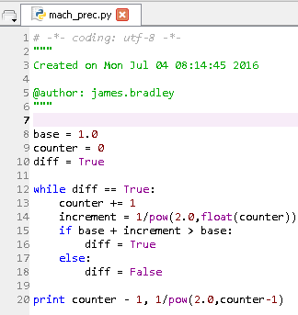
Machine Precision
We can test the limits of our computer’s precision capabilities
What is the smallest number that we can add to one that is “recognized” by the computer?

Slide 131
Loops
Loop control
break breaks out from the lowest level for or while loop
continue skips remainder of the current loop iteration and proceeds with the next iteration
Let’s revise the last program to use these concepts

Slide 132
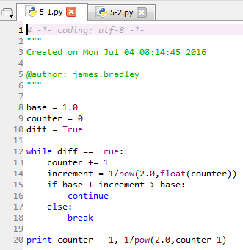
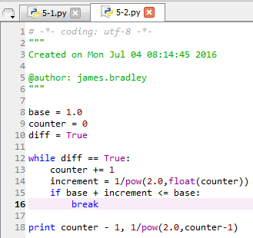
Loops
break and continue examples
5-1.py and 5-2.py

Slide 133
Exercise
Exercise 5.1, pg. 65

Slide 134
Exercises
Write a program, using a lambda function, to print the square root of numbers 10 and less using a loop.

Slide 135
Chapter 7 Files: Reading and Writing

Slide 136
Files
f = open('file_with_path','r')
file_ref | Reference to file use in Python program. Use this later for reading & writing
file_with_path | String that describes path and file name. If path omitted, then Python will look in same folder as where program is stored
'r' | 'r' ‘ = read from file 'w' = write to file. If filename exists it is erased before writing commences 'a' = append 'r+' = reading and writing If omitted, 'r' is assumed
https://docs.python.org/2.7/tutorial/inputoutput.html

Slide 137
Files
Frequently used file functions
f.read()
Reads entire file
f.readlines()
Reads message in lines into list of string (str) data
for thisLine in f:
for-loop to iterate through the lines in the file
f.write()
Writes to a file
f.close()
Always close the file after use to ensure output to file and conserve memory
https://docs.python.org/2.7/tutorial/inputoutput.html

Slide 138
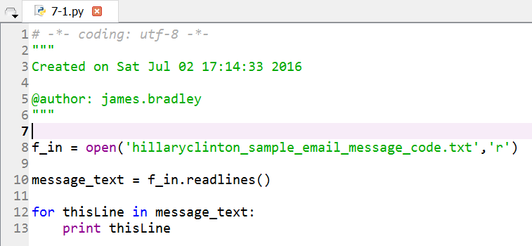
Files
Read Hillary Clinton’s email messages
Email file is in same folder as Python code
7-1.py

Slide 139
Files
Move email file to the data folder
What happens?

Slide 140
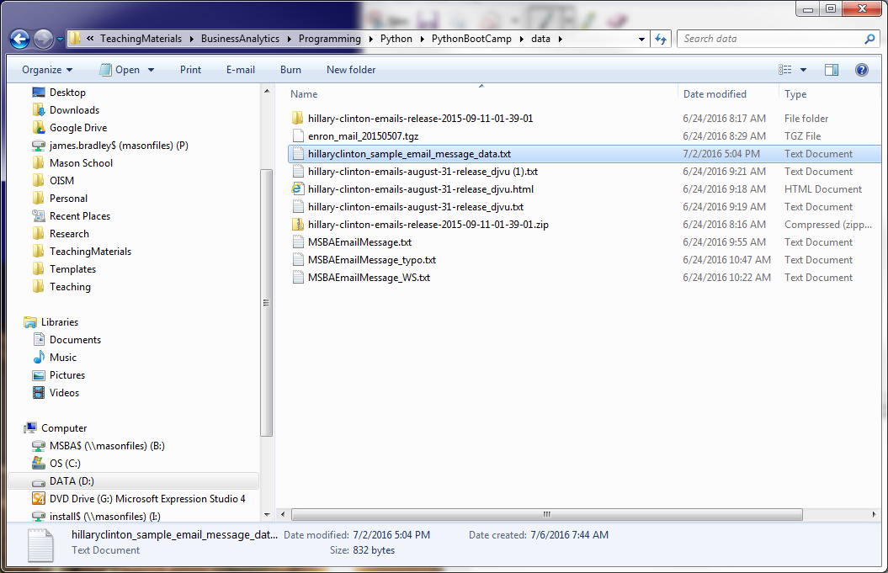
Files
Telling Python where to read and write
No path specification needed if file is in the same folder as the code being executed
Folder path for file is needed otherwise
Use Windows File Explorer to get path

Slide 141
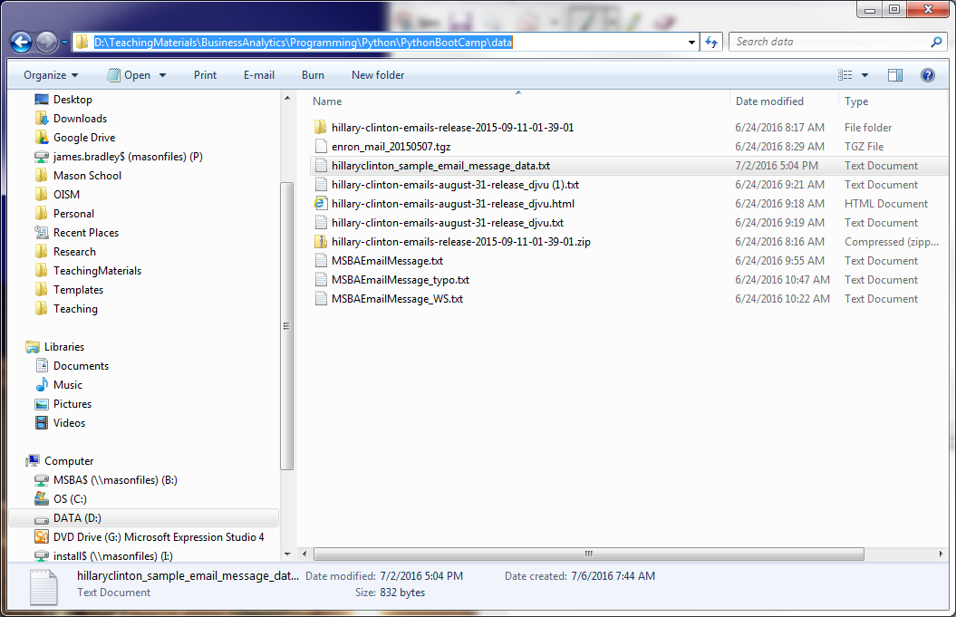
Files
Use Windows File Explorer to get path
Left-click on address bar
Ctrl+c to copy
Ctrl+v to paste in Python code

Slide 142
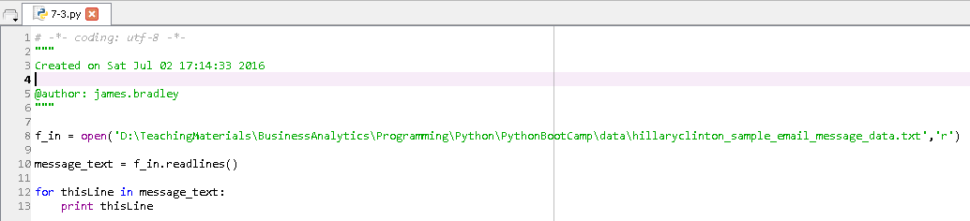
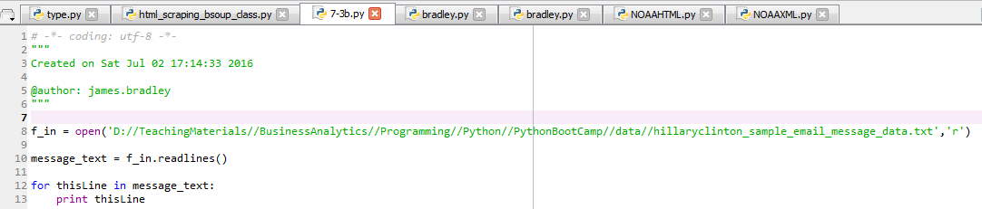
Files
7-3.py
… or 7-3b.py

Slide 143
Files
Single backslashes, “\”, are interpreted as escape characters
For example, “\n” or “\r\n” means carriage return, newline
For our text encoding, usually “\n”

Slide 144
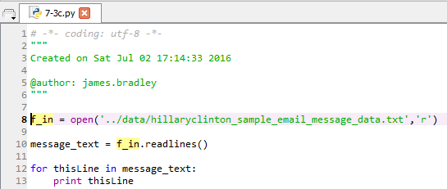
Files
… or 7-3c.py
“..” moves up one folder level

Slide 145
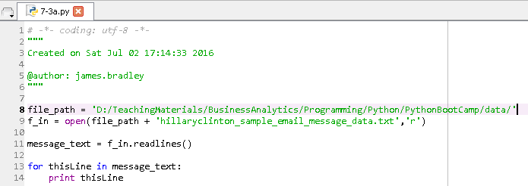
Files
Clean it up (7-3a.py)
Store path in string variable
Replace “\” with “/” or “\\”
“\” is the escape character

Slide 146
In-Class Exercise
Read this file and print the data out
your_root\PythonBootCamp\data\tuples.txt
Take a look at the data first
Version 2
Split the data at the commas using string.split(',')
Each line in the email message file was in string data type format
Notes:
7.4.py

Slide 147
Chapter 8 Data Structures: Lists

Slide 148
Lists
[7, 2, 5, 3, 1, 9, 8]
A list is simply a list of data objects
Values in a list need not all be of the same type
… but usually they are
Lists are specified with brackets
[the list elements are in here separated by commas]
The elements in a list are separated by commas
List elements can be lists, tuples, & dictionaries…
We’ll talk about this later
Mutable
Elements can be changed

Slide 149
Lists
Type these statements into the Console:
How many elements are in a list?
You can access list values by their indices
What do you get when you type myList[1]?
Did you get the value you expected?
myList = [7, 2, 5, 3, 1, 9, 8]
print type(myList)
len(myList)

Slide 150
Lists
List indices are 0-based
That is, they start at zero
A list with 10 elements has indices 0 through 9

Slide 151
Lists
list.append() inserts an element onto the end of a list
The method accepts one argument
Example
myList.append(6)

Slide 152
In-Class Exercise
Use the list.append() method and a loop to create a list of odd integers from 1 through 15.

Slide 153
Lists
You can use the range() function to create a range encompassing:
So, what?
We can use this for loops:
This is an often-used code pattern:
Cycles through all list elements without knowing beforehand how many there are
print range(len(myList))
for i in range(len(myList)):
print i, myList[i]

Slide 154
Lists
Lists of strings
Print out the list:
Side comment: use '\n' to put a carriage return (newline) between index and value
myListString = ['zero','one','two']
for i in range(len(myListString)):
print i, myListString[i]
for i in range(len(myListString)):
print i, '\n', myListString[i]

Slide 155
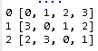
Lists
Lists of lists
How do we index this?
Do an experiment:
So, this indexes us through the elements in the ‘outer’ list
Any guesses on how to index through the ‘inner’ lists?
myListInt = [[0,1,2,3],[3,0,1,2],[2,3,0,1]]
for i in range(len(myListInt)):
print i, myListInt[i]

Slide 156
Lists
What is your guess about what this will do?
Hierarchical
First index accesses elements in outer list
Each successive index dives one level “deeper” into a list of lists
How many elements are in the 2nd sub-list?
print len(myListInt[1])
myListInt = [[0,1,2,3],[3,0,1,2],[2,3,0,1]]
print myListInt[1][1]

Slide 157
Lists
Check this out! Nested ‘for’ loops
Can also do this:
… or this
in automatically chooses index
myListInt = [[0,1,2,3],[3,0,1,2],[2,3,0,1]]
for i in range(len(myListInt)):
for j in range(len(myListInt[i])):
print myListInt [i][j]
myListInt = [[0,1,2,3],[3,0,1,2],[2,3,0,1]]
for row in myListInt:
for element in row:
print element
myListInt = [[0,1,2,3],[3,0,1,2],[2,3,0,1]]
for row in myListInt :
print row

Slide 158
In-Class Exercise
How would you access the value 5?
myList2 = [[[0,1],[2,3],[4,5]],[[6,7],[8,9],[10,11]]]

Slide 159
Lists
Appending a list into a list
myListInt = [[0,1,2,3],[3,0,1,2],[2,3,0,1]]
myListInt.append([1,2,3,0])
print myListInt

Slide 160
Back to Variable Names
Another consideration in choosing variable names is striving to create loops that are understandable in English
That is, mnemonic, descriptive names

Slide 161
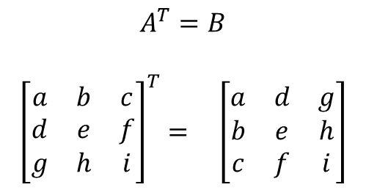
Lists
Compute transpose of 2-dimensional list
A[0,1] = b
For each i,j, B[j][i] = A[i][j]
$$A^{T}=B$$
$${\left[\begin{matrix}a & b & c \\ d & e & f \\ g & h & i\end{matrix}\right]}^{T}= \left[\begin{matrix}a & d & g \\ b & e & h \\ c & f & i\end{matrix}\right]$$
0
1
2
0
1
2
0
0
1
1
2
2
a = [[0,1,2],[2,0,1],[1,2,0]]
b = [[0,0,0],[0,0,0],[0,0,0]]
for i in range(len(a)):
for j in range(len(a[i])):
b[j][i]=a[i][j]
print a
print b

Slide 162
Lists
Mutable means you can change a value
Lists are mutable
myList = [[0,1,2],[2,0,1],[1,2,0]]
for row in myList:
for element in row:
print element
print '\n\n'
myList[1][2] = 99
for row in myList:
for element in row:
print element

Slide 163
Lists
Lists are mutable: another example
Print code automatically adjusts to number of elements in the sub-lists
myList = [[0,1,2],[2,0,1],[1,2,0]]
for row in myList:
for element in row:
print element
print '\n'
print '\n', 'space between results','\n'
myList[1] = ['zero', 'one']
for row in myList:
for element in row:
print element
print '\n'

Slide 164
In-Class Exercise
This is a little tough!
You will need to do some more research
Open this file:
your_root\PythonBootCamp\data\list.txt
It is comma delimited
Write code to transform each row into a list that is appended to an outer list
i.e., create a 2-dimensional list

Slide 165
Lists
test_list = [1,3,5,7,9,11]
Slices
test_list[1:]
Get elements 1 through the end of the list
test_list[1:3]
Get elements 1 through 2
test_list[:3]
Get elements from the beginning of the list element 2
test_list[2]
Get element 2

Slide 166
Lists
Appending to lists:
test_list.append(13)
test_list.append([13])
test_list = test_list.append([13])
test_list = test_list +[13]
test_list = test_list + 13
test_list + 13
Red means incorrect or probably not what you want to do

Slide 167
Lists
Here’s the difference:
.append() directly changes the list and returns nothing
Do not set it equal to some variable
+ creates a new list
You need to set it equal to something or nothing will happen
Confusing to have two append methods?
Advice
Pick one method and use it consistently

Slide 168
Lists
Sometimes initializing lists of a certain size is useful….
Create list of elements with constant values
The * operator used with lists means create a multiplicity of items rather than multiplication
test_list2 = [1]*5

Slide 169
Lists
Other methods that operate directly on lists
.sort()
This sorts the list in place: it does not return an value
.sort(reverse=True)
.pop(index)
Returns the first element in a list and deletes it from the list
t = [11,9,7,5,3,1]
t.sort()
print t
t.sort(reverse=True)
print t
s = t.pop(2)
print s
t.pop(2)
t.remove(0)

Slide 170
Lists
Other methods that operate directly on lists
.remove(value_to_remove)
.extend(list_var)
Appends one list onto another
t = [11,9,7,5,3,1]
w = [-1,-3,-5,-7]
t.extend(w)
print t
print w

Slide 171
Lists
Can also use the built-in Python function sorted() to sort
Does not perform sort in place
Rather, it returns a copy of the sorted entity
Be careful of methods that return copies and those that perform operations on the entity in place

Slide 172
Lists
Other built-in functions that operate on lists:
del t
del t[2]
del t[1:3]
t = [11,9,7,5,3,1]
del t[4]
print t
del t[1:3]
print t
del t
print t

Slide 173
Lists
Built-in functions used on lists similar to len() function
min()
max()
sum()
t = [11,9,7,5,3,1]
print min(t)
print max(t)
print sum(t)

Slide 174
Lists
Unsure about whether a statement will work?
Test it out in the Console or in Jupyter

Slide 175
In-Class Exercise
Write a script that:
Creates a list of integers from 0 to 15
Deletes the elements in positions corresponding to indices 2, 5, and 7
Prints out the min, max, and sum of the remaining elements
Computes, and prints the average of the remaining elements

Slide 176
Aliasing
p = 3
q = p
p = 1
print p
print q
This behavior is intuitive for numerical quantities

Slide 177
Aliasing
p = [1,2,3]
q = p
q[1] = 9
print p
print q
What are the values of p and q?

Slide 178
Aliasing
p = [1,2,3]
q = p
q[1] = 9
print p
print q
This is aliasing
… not necessarily intuitive
In this case, p and q both reference the same location in memory
You are not creating a new object in memory referenced by q

Slide 179
Aliasing
How to avoid aliasing (when you want to):
Make a copy of the list
Be careful of unnecessary copies of lists
Consumes memory
p = [1,2,3]
q = p[:]
q[1] = 9
print p
print q

Slide 180
Lists and Functions
Let’s go through the examples in 8-1.py
The difference is
Knowing which statements operate directly on the lists and which create new lists
Knowing when a value is passed to a function versus a reference (pointer)

Slide 181
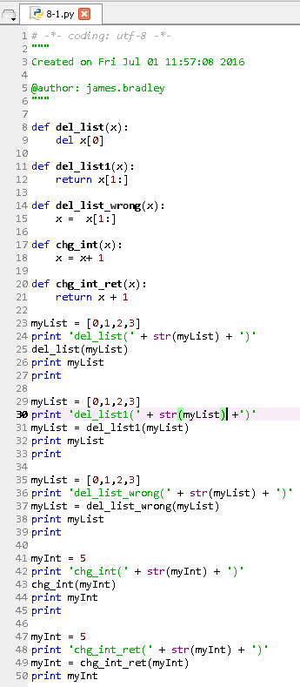
Lists and Functions

Slide 182
In-Class Exercise
Write a function the deletes the last element of a list which is passed to it as an argument, and then returns the truncated list

Slide 183
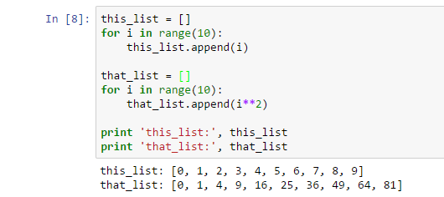
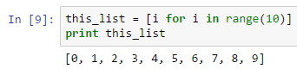

List Comprehension
We know what these programs do:
The shorthand for creating these lists are
See 8-2.py

Slide 184
List Comprehension
The value you want to append to the list based on the variable quantities you are iterating through.
Square brackets indicate that a list is being created
An expression that causes a variable, i in this case, to iterate over many values. You can iterate through lists, dictionaries, tuples and other data structures.

Slide 185


List Comprehension
Lambda function in a loop
Lambda function in list comprehension
We’ll talk about list comprehension later

Slide 186

List Comprehension
Can use if statements in list comprehension

Slide 187
In-Class Exercise
Write a list comprehension statement that creates a list of even numbers from 0 through 16.
Write a list comprehension statement that iterates over the following list and only includes values if they are even
my_list = [5,11,12,34,51,62,8,18,19,20,21]
Do so with and without a lambda function

Slide 188
Exercise Solutions
Create a list of even numbers
LCEven.py
Sort through a list and print a number only if it is even
LCSortEven.py

Slide 189

List Comprehension
You can use logic in list comprehension statements:

Slide 190


List Comprehension
Here’s a couple more examples:

Slide 191
In-Class Exercise
Write a list comprehension statement that filters a list of integers from 0 to 100 and prints out the square of the integers, for each integer that is a multiple of 5.
Another way of saying this is that your should square the integers which are evenly divided by 5.

Slide 192
Chapter 9 Data Structures: Dictionaries

Slide 193
Dictionaries
myDict = {'zero':0,'one':1, 'two':2}
Dictionaries are sequences of key-value pairs
Specified by curly braces {put key-values here}
Like lists, but find values using keys, not indices
Colons separate keys and corresponding values
Commas separate key-value pairs
Values are mutable
Try this
print myDict ['zero']
myDict ['zero'] = 99

Slide 194

Dictionaries
Get number of key-value pairs
Get keys
Result (note order)
To impose order on keys:
len(myDict)
print myDict.keys()
['zero', 'two', 'one']
key_list = myDict.keys()
key_list.sort()
print key_list

Slide 195
Dictionaries
Get dictionary values:
myDict.values()
myDict = {'zero':0,'one':1, 'two':2}
val_list = myDict.values()
print val_list

Slide 196
Dictionaries
Can you think of a way to use key_list to print out all the key-value pairs in myDict in order of the keys?
myDict = {'zero':0,'one':1, 'two':2}
key_list = myDict.keys()
key_list.sort()
print key_list
for thisKey in key_list:
print myDict[thisKey]
for thisKey in key_list:
print thisKey,':',myDict[thisKey]

Slide 197
Dictionaries
Looking for a key?
Use in and myDict.keys()
Also note the use of " and '
myDict = {'zero':0,'one':1, 'two':2}
key_list = myDict.keys()
print "Find key = 'zero':",'zero' in key_list
myDict = {'zero':0,'one':1, 'two':2}
print "Find key = 'zero':",'zero' in myDict.keys()

Slide 198
Dictionaries
Looking for a value?
Use in and myDict.values()
“\” is used here for line continuation
Typing a statement across multiple lines
myDict = {'zero':0,'one':1, 'two':2}
print "Find value = 0:", 0 in myDict.values()
print "Find value = 2:", 2 in myDict.values()
print "Find values = (0,2):", 2 in myDict.values() \
and 0 in myDict.values()

Slide 199
Dictionaries
A concise way to loop through:
So what is happening in the first line vis-à-vis element and myDict?
for element in myDict:
print element,':', myDict[element]

Slide 200
Dictionaries
Another concise way to loop through:
for key,value in myDict.items():
print key, value

Slide 201
Dictionaries
Use a dictionary to create a histogram
Histogram: counts the frequency of occurrence for each value in a set of data
Assume that the data is in a list
For example, a histogram of this list,
[0,1,3,5,2,3,1,0,0,3,4,5]
is this:
0:3, 1:2, 2:1, 3:3, 4:1, 5:2
Value found in list
Number of times a value appeared

Slide 202

Dictionaries
hist = {}
Curly braces on right create an empty dictionary
Try this in 9-hist.py. What happens?

Slide 203

Dictionaries
If a key does not exist we need to create it
9-hist1.py

Slide 204

Dictionaries
It works. Can we do better?
Use dictionary .get() function
Creates a dictionary element if key is missing
9-hist2.py

Slide 205
Side Comment
for y in x:
y will cycle through all the elements in x
Which values y takes on depends on the data type of x
Lets experiment:
x1 = [0,1,2,3]
x2 = [[0,1],[2,3],[4,5]]
x3 = [(0,1),(2,3),(4,5)]
x4 = 'Try this'
x5 = {'one':'uno','two':'dos','three':'tres'}

Slide 206


Looping through Dictionaries
y will iterate through keys of dictionary x5
You can also iterate both keys and values
See 9dictLoop.py

Slide 207


Looping through Dictionaries
You can also iterate through values
Iterate dict. elements in order of sorted keys
See 9dictLoop.py

Slide 208
In-Class Exercise
Create a script to:
Read data in your_root\data\words.txt
Create a histogram counting the number of times each word appears in that file
Print out the histogram data
Hints:
string.rstrip('\n') removes the carriage return “\n” at the end of the line
string. split(' ') breaks a string into multiple strings at the empty spaces and puts the words into a list
string.strip() strips all leading & trailing whitespace characters

Slide 209
Chapter 10 Data Structures: Tuples

Slide 210
Tuples
x = (1,2)
y = ('blue','green')
z = ('red',255,0,0)
Tuples are like lists
Except they are immutable
Values of tuple elements cannot be changed
Tuple elements cannot be deleted
The entire (outer) tuple can be deleted
Specified by parentheses
Elements separated by commas
Tuples can have any number of elements
Any data type

Slide 211
Tuples
Let’s try these statements:
You can access tuple values using indices just as is possible with lists
x = (0,1)
print x[0]
y = ((0,1),(2,3))
print y[0]
print y[0][1]

Slide 212
Tuples
Let’s try these statements:
A tuple of tuples:
You cannot delete elements in tuples
y = ((0,1),(2,3))
del y[0]
del y[0][1]

Slide 213
Tuples
Let’s try these statements:
You can replace tuples with other tuples
y = ((0,1),(2,3))
y[0] = (4,5)
print y
y = (4,5)
print y

Slide 214
Tuples
Be careful! (a potential error)
1-tuples are possible but need a comma after the element
If you have a 1-tuple, then you must access the element’s value using an index as in the last statement
t1 = (0)
t2 = (0,)
print type(t1)
print t1
print t1[0]
print type(t2)
print t2
print t2[0]

Slide 215
Tuples
You can have tuples of lists:
Let’s try these statements:
What did you find?
z = ([0,1],[2,3])
z = ([0,1],[2,3])
print z[0]
print z[0][1]
del z[0]
del z[0][1]
del z[0][0]

Slide 216
Tuples
Slices work with tuples:
z[1:],z[:2],z[1:2]
Using sorted() with tuples
z = ((0,1),(3,3),(2,3))
sorted(z)
print z
print sorted(z)
w = sorted(z)

Slide 217

Tuples
A unique feature in Python (see 10-1.py)
Multiple variables on left-side of statement
Python automatically makes the intuitive assignments, if one is possible

Slide 218
In-Class Exercise 1
Use your solution to this exercise as a basis for the following exercise
Transform the histogram dictionary into a list of tuples in the format of (key, value)…
Then, sort the list in descending order
Print out list

Slide 219
Data Structures
It’s easy to make mistakes with data structures:
When you think you are using one data type but you are actually using another
Gives you errors or, worse, doesn’t reveal itself as an error
Severance: “shape errors”
In debugging use the type() function to check yourself

Slide 220


Data Structures
Shape errors
“…errors caused when a data structure has the wrong, type, size, or composition.”
Example
Lists have length (len()), integers do not

Slide 221

Data Structures
Shape error examples
10-3.py

Slide 222
Tuples
Tuples can have any number of entries of any data types
E.g., a tuple with three elements is called a 3-tuple
(15,22,29)

Slide 223
In-Class Exercise 2
2-tuples of integers represent the indices of Wal-Mart distribution centers that serve Wal-Mart stores
For example, (2,4) means that distribution center 2 supplies store 4
Indices are associated with locations
stores and dcs dictionaries

Slide 224

In-Class Exercise 2
Open template 10-4.py, insert your code, and save it as 10-4my.py in code folder

Slide 225
In-Class Exercise 2
Write a program that:
Elicits an integer from a user using raw_input() that represents a distribution center
DC indices run from 0 to 5
Prints out a nice heading saying that this analysis is for a particular DC number located at a particular location
Prints out all store locations served by the DC whose index that was entered

Slide 226
In-Class Exercise 3
This one is tough!
It will require some additional research
Read this file and transform into tuples
your_root\PythonBootCamp\data\tuples.txt
Henceforth, I will not mention the data subfolder specifically:
All data files will be in that folder
your_root\PythonBootCamp\data

Slide 227
Chapter 10.1 One More Data Structure: Sets

Slide 228
Set Data Type
Sets are not often used, but are sometimes useful
Think of a set as:
A list where an item can occur only once
Designated by curly braces, {}, like dictionaries
There is also the frozenset data type
It is immutable
Reference:
https://docs.python.org/2/library/sets.html

Slide 229
Set Data Type
set data types are mutable
.add(), .remove()
Cannot use as dictionary keys
frozenset data types are immutable
Can use as dictionary keys
Faster access
Both data types are iterable, can use in:
for loops
List comprehension

Slide 230
Creating a Set
From a list:
my_list = [‘bean’, ‘pea’, ‘corn’, ‘pea’]
my_set = set(my_list)
print my_set
print type(my_set)
Directly
fruit = {‘apple’, ‘pear’, ‘orange’, ‘banana’}
Both dictionaries and sets are denoted with curly braces, by Python will interpret this as a set based on the lack of colons

Slide 231
Set Data Type
Can check if item x is in a set, or not
if x in this_set:
if x not in this_set:
Check if this_set is subset of that_set
if this_set.issubset(that_set):
if this_set ≤ that_set:
Is this_set is superset of that_set?
if this_set.issuperset(that_set):
if this_set ≥ that_set:

Slide 232
Set Data Type
Other set methods to know about:
my_set = {1, 2, 3}
set.union(set1, set2)
set.intersection(set1, set2)
my_set.clear()
x = my_set.pop()
Removes first element of my_set and assigns it to x
my_set.add()
my_set.remove()

Slide 233
Set Examples
Get a list of people who emailed Hillary with each address listed once
Get a list of distribution center picking locations for a picking route with each location listed once
Get a list of suppliers for parts of a finished good with each supplier listed once

Slide 234
In-Class Exercise 1
Create a set of the words used in this poem, Poem About life, by Emily Dickinson:
If I can stop one heart from breaking,
I shall not live in vain;
If I can ease one life the aching,
Or cool one pain,
Or help one fainting robin
Unto his nest again,
I shall not live in vain.
See pal.txt and pal.ipynb

Slide 235
In-Class Exercise 2
Read all the input from the data source in this exercise by appending each term to a list.
Use a set conversion to create keys for the dictionary so that the dictionary.get() method is unnecessary.

Slide 236
More Sorting

Slide 237
More Sorting
You will do a lot of sorting in analytics
Useful to know many ways to sort data

Slide 238
YouTube Videos
https://www.youtube.com/watch?v=bqwWJpaIm8M&list=PLxYh7ZSzU5052ugdqSbsVvfqU1jQVOJTI&index=2
https://www.youtube.com/watch?v=UmUiu59e17Q&list=PLxYh7ZSzU5052ugdqSbsVvfqU1jQVOJTI&index=3
https://www.youtube.com/watch?v=C3VJlPly_vs&index=4&list=PLxYh7ZSzU5052ugdqSbsVvfqU1jQVOJTI

Slide 239
Homework Problem 1
Watch the first Youtube video
Sort this list of tuples in ascending order of the 3rd element within each tuple using the operator.itemgetter() method
Data (copy and paste into Spyder/Jupyter)
[(1,9,11,15),(4,6,10,14),(2,5,12,13),(3,7,8,16)]

Slide 240
Homework Problem 2
Watch the second Youtube video
Sort the data in Problem 1 using a lambda function

Slide 241
Homework Problem 3
Use your solution to this exercise as a basis for the following exercise
Transform the histogram dictionary into a list of tuples in the format of (key, value)…
Then, sort in descending order of frequency
From previously mentioned videos:
from operator import itemgetter
list.sort(key=itemgetter(1),reverse=True)
Use a lambda function
Print out list

Slide 242
Chapter 11 Regular Expressions

Slide 243
Regular Expressions
Recognizing REGularly occurring character patterns (EXpressions)
Regex
Regex cheat sheets
http://regexr.com/
http://www.rexegg.com/regex-quickstart.html
https://www.cheatography.com/davechild/cheat-sheets/regular-expressions/

Slide 244
Regular Expressions
Purposes
Finding patterns of characters
For processing text, strings
Validating data entry:
Email addresses, phone numbers, social security numbers
Replacement, substitution
Cleaning text
Removing characters
Stripping whitespace characters, punctuation
Parsing text
Splitting strings into a list of words at occurrence of particular characters
Preliminary steps for text analysis

Slide 245
Regular Expressions
Examples
Search email message text and extract the email addresses associated with the text From
Strip carriage returns, \n, from text files
Search for characters with accents to detect foreign languages, e.g., ò
How?
Express the pattern in which you are interested using letters, numbers, and special characters
i.e., the Regex language

Slide 246
Regular Expressions
Regex examples (explore with regexr.com):
^: starts with some pattern
$: ends with some pattern
[]: match any of the characters in brackets
[a-z]: any lower case character
[a-zA-Z]: any letter
[0-9] or \d: any digit
.: any character, wildcard
\s: any whitespace character
\S: any non-whitespace character
Repetition of a (sub-)pattern
+: 1 or more; *: 0 or more; ?: 0 or 1
Use () to group conditions
|: Logical OR

Slide 247
Regular Expressions
Searching for From:
Exactly: From
Starts with F and ends with m with any number of letters between: F[A-Za-z]*m
Above, but permits upper of lower case F and m: [fF][A-Za-z]*[mM]
Above, but limits intermediate letters to 2: [fF][A-Za-z]{2}[mM]
Above, but limits intermediate letters to between 1 and 3: [fF][A-Za-z]{1,3}[mM]
Or, permit any number of any characters between: [fF].*[mM]

Slide 248
Regular Expressions Warm Up
Practice with regexr.com
Find numeric expressions
[0-9]+ or [0-9\.]+
Find consecutive sequences of characters
[A-Za-z]+
Find whitespace characters
\s
Find consecutive whitespace characters
\s+
Find all instances of s and t
s|t or [st]
Find all instances of ss and tt,
ss|tt
Find all instances of a period

Slide 249
In-Class Exercise
Write a Regex expression to find numbers in any of these formats
1234, 12.34, .1234, 1234.
… with any number of digits before and after a possible decimal point
Experiment, prototype with regexr.com

Slide 250

Regular Expressions
Python package
import re
Start with this code:
numericalFindTemplate.ipynb
See my solution: numericalFind.ipynb

Slide 251
Regular Expressions
Python Regex References
https://docs.python.org/2/library/re.html
https://docs.python.org/2/howto/regex.html

Slide 252
Regular Expressions
Frequently used methods
re.findall(regex, string2search)
Find this pattern: regex
In string2search
Return all instances of string2search in a list
re.find(regex,string2search)
Find the first, or first n instances
re.sub(regex,sub_text,string2search)
Substitute this text: sub_text
For this text: string2search

Slide 253
Regular Expressions
Frequently used methods
re.search('text_2_find','text_2_search')
Finds 'text_2_find'
Within the string 'text_2_search‘
If text_2_search is found then returns a re.match object
<_sre.SRE_Match at 0x3912b28>
Otherwise, returns a result of the NoneType

Slide 254

Regular Expressions
Investigate fromRegexrDotCom.txt
Do these tasks:
Find all consecutive strings of integers
Find words that start with wW
Find all Internet domains: xxx.xxx.xxx

Slide 255
Regular Expressions
Investigate fromRegexrDotCom.txt
One more task:
Substitute zz for each instance of ss

Slide 256

Regular Expressions
Solution: BootCampRegexSoln.ipynb

Slide 257
Regular Expressions
Regex Case Study 1: Detect email addresses

Slide 258
Regular Expressions
A more complex example…
Mimic how regex development might proceed
Find email addresses in Hillary Clinton’s email
With whom did she correspond?
Email addresses have this symbol: @
Use regexr.com for prototyping
11-0.py looks for “at sign” @ … a bit silly
Use regexr.com to develop the code for letters before and after

Slide 259

Regular Expressions
Find email addresses (11-2.py)
Change the file path for your computer
‘\S+@\S+’
\S matches any non-whitespace character
+ looks for any number of those characters
@ matches @
Translated
Any series of characters before the @, and any series of characters after
Pattern is interrupted on either end by whitespace

Slide 260

Regular Expressions
How long did this take?
Use the time package to find out
import time

Slide 261

Regular Expressions
Still some housekeeping to do…
Get rid of (most) extraneous characters at beginning and end of extracted addresses
E.g., [, ], <, >
'[a-zA-Z0-9]\S*@\S*[a-zA-Z]'
A single letter or number
Followed by zero or more non-whitespaces
Followed by @
Followed by zero or more non-whitespaces
Followed by a letter

Slide 262

Regular Expressions

Slide 263

Regular Expressions
Still some housekeeping to do…
Check output for further required filtering
Use re.sub()to delete unwanted characters

Slide 264
Regular Expressions
Study email address specifications:
https://en.wikipedia.org/wiki/Email_address
Further possible refinements:
One or more repetitions of letters/numbers and a dot after the @ followed by 2 to 5 letters
Letters/numbers and other allowable characters before the ampersand
Discussion
Escape character, \
If you mean a period, then use \.
If you mean a backslash then \\

Slide 265
Regular Expressions
Regex to detect email addresses
http://regexlib.com/Search.aspx?k=email&AspxAutoDetectCookieSupport=1
([a-zA-Z0-9_\-\.]+)@([a-zA-Z0-9_\-\.]+)\.([a-zA-Z]{2,5})
http://stackoverflow.com/questions/46155/validate-email-address-in-javascript
(([^<>()\[\]\.,;:\s@\"]+(\.[^<>()\[\]\.,;:\s@\"]+)*)|(\".+\"))@(([^<>()[\]\.,;:\s@\"]+\.)+[^<>()[\]\.,;:\s@\"]{2,})
http://emailregex.com/

Slide 266
Regular Expressions
Courses:
https://regexone.com/
https://teamtreehouse.com/library/regular-expressions-in-python
Caveat:
I haven’t taken these courses

Slide 267
In-Class Exercise
Write regex for detecting phone numbers with area code, which would flag these types of patterns:
617.555.1212
467-927-5823
Extra credit; detect these also:
(517) 321-2725
(800)-555-1212

Slide 268

Exercise
Possible solution

Slide 269
Regular Expressions
Regex Case Study 2: Create histogram of word usage
How many times is each word used?
A dictionary is useful
This is one of the basic skills in text mining, natural language processing, unstructured data (of the textual nature), or whatever you want to call it

Slide 270
Case 2 Steps
Input text
Convert text to lower case
‘She’ and ‘she’ should be combined in the same histogram bin
Remove punctuation
re.sub(), str.replace()
Split text into words
str.split()
remove whitespace from right and left
str.strip()
Make histogram w/dictionary .get statement

Slide 271
Regular Expressions
Other functions for stripping characters:
rstrip() strip all whitespace from right side
lstrip() strip all whitespace from left side
You can strip other character patterns from string variables by inserting arguments in lstrip(),rstrip(), and strip()

Slide 272
Basic Text Analysis
Shakespeare’s Hamlet
http://www.nosweatshakespeare.com/quotes/hamlet-to-be-or-not-to-be/
Text file: HamletSililoquy.txt
Solution file: ShakespeareParse.py
Tasks
Open file
Split text into lists of words
Look for other desirable text processing steps
Create frequency histogram of words with a dictionary
Print out the frequency histogram data in descending order of frequency
Bonus: plot the frequency histogram

Slide 273
Regular Expressions
Regex Case Study 3: Find email text corresponding to “From” lines
You might want to document all people who sent email to another particular person
Retrieve and manipulate data, then re-search

Slide 274

Regular Expressions
Example: Find line containing 'From'
You will need to change the file path for your computer

Slide 275

Regular Expressions
Find only lines starting with 'From'?
Use caret: ^
re.search('^From', line):
To match end of string use $

Slide 276

Regular Expressions
What if you cannot count on 'From' being the first characters because extraneous whitespace characters sometimes are inserted at the beginning of a line?
Then use lstrip()on the string variable

Slide 277
Regular Expressions
What if target text is sometimes misspelled?
No problem!
Okay, this is a bit tougher
You can’t guarantee how the misspelling will occur and there can be many, many ways
Use a wild card character:
. Matches anything but a newline character
Use repetition operators: *,+,?,*?,+?,??
See https://docs.python.org/2/library/re.html
Let’s try '^F.*m:'
Matches any string that starts with F and ends with m: with any number characters between

Slide 278

Regular Expressions
11-1c.py
You will need to change the file path for your computer

Slide 279

Regular Expressions
Did we find all of the times?
len(time_list)
Oops, let’s take a closer look…

Slide 280
Regular Expressions
Multiple formats:
hh:mm:ss
hh:mm
h:mm
h :mm
Requires re-specification to catch all of these possibilities

Slide 281
Regular Expressions
To find all email addresses on From lines
Use multiple findall() on the lines that start with From
Actually, you should be able to use find()
Email can be sent from only one account

Slide 282
Exercise
Create a frequency histogram from the addresses we extracted from Hillary Clinton’s email
For each email address, how many messages were sent?
Why would we want to do this?
Note: we should be asking this question before we decide to write the program

Slide 283
The numpy Package

Slide 284
numpy
The numpy package (and pandas) are widely used
https://www.quora.com/What-are-the-best-Python-libraries-and-packages-for-data-science

Slide 285
numpy
Numerical analysis for Python
Some courses focus entirely on numpy
This is just an introduction to make you aware of numpy
Reference to numpy methods
https://docs.scipy.org/doc/numpy/reference/routines.html
Let’s use a Jupyter notebook to investigate numpy

Slide 286
numpy Methods Examples
Import numpy
import numpy as np
The np alias is typical
numpy has it’s own sort method
In general, faster than the built-in Python method
x = np.array([3,2,1])
x.sort()
In-place sort

Slide 287
numpy Methods Examples
Array (matrix, vector) creation
Matrix: A = np.array([[1,2,3],[4,5,6],[7,8,9]])
Vector: x = np.array([1,1,1])
x behaves like a column vector although it was entered in row vector form
Get array dimensions: A.shape, x.shape
Accessing numpy array elements
A[0,1] or A[0][1]
Array manipulation
np.transpose(A)

Slide 288
numpy Methods Examples
Array creation, again:
Create a matrix of zeros with 2 rows and 3 columns
np.zeros((2,3))
Create empty matrix with 3 rows and 5 columns
np.empty(shape=(3,5))
Create matrix with random values
np.random.rand(3,5)
Convert a vector into a diagonal matrix
np.diag([1,1,1])

Slide 289
numpy Methods Examples
Dot product
The dimensions must be appropriate
np.dot() takes 2 arguments
np.dot(A,x)
Nest .dot() to multiply 3 or more arrays
np.dot(np.dot(x,A),x)
Note the dimensions of the vector x are automatically made appropriate for dot product
2-dimensional arrays (matrices) are not adjusted
R = np.ones((2,3))
T = np.ones((2,3))
np.dot(R,T)
This will result in an error

Slide 290
numpy Methods Examples
Dot product
You can create a ‘matrix’ using np.matrix()rather than np.array()if your arrays are at most 2-dimensional
A_m = np.matrix([[1,2,3],[4,5,6],[7,8,9]])
x_m = np.matrix([1,1,1])
Accessing matrix elements
A_m[0,1]
A_m[0][1]doesn’t work like in numpy arrays
Vector dimensions will not be corrected when using np.dot(A_m,x_m)
Also use * for dot product with np.matrix():
A_m * x_m (doesn’t work)
A_m * np.transpose(x_m)

Slide 291
numpy Methods Examples
Matrix inverse:
np.linalg.inv()
Solve systems of linear equations
Solve Ax = b
np.linalg.solve(A,b)
A must be square and of full rank

Slide 292
numpy Exercise
Find a mix of cereals (number of grams each) that has 245 calories, 6 grams of protein, and 7 grams of fat
Nutritional info for cereals [calories,protein,fat]
Cheerios [120, 4, 2]
Cap’n Crunch [130, 3, 5]
Rice Crispies [105, 1, 2]
Solve Ax = b without using np.linalg.solve()
A = [[120,130,105],[4,3,1],[2,5,2]]
b = [245,6,7]
Check with np.linalg.solve()

Slide 293
numpy Methods Examples
Eigenvalues and Eigenvectors
np.linalg.eig()
Eigenvectors/values
λ is an eigenvalue of a matrix A and v its corresponding eigenvector if Av = λv
A matrix A meeting certain conditions, can be factored as A = QΛQ⁻¹
Λ is a diagonal matrix with eigenvalues on the diagonal
Columns of Q contain the eigenvectors

Slide 294
SVD
Singular Value Decomposition
np.linalg.svd()
Singular Value Decomposition of a matrix is a generalization of eigenvector/value decomposition of a matrix
Eigenvector/value decomposition for n×n matrices
SVD for m × n matrices, m not equal to n

Slide 295
SVD
Similarly, an m×n matrix B can be factored as B = UΣV^{T}
Σ is a diagonal matrix whose diagonal elements are the singular values
Columns of V contain the eigenvectors
Same as rows of V^{T}

Slide 296
Eigen-analysis & SVD
Eigenvectors
Are directions of maximal variation in the data
Are orthogonal to one another
Dot products of eigenvectors are zero
Eigenvalues/Singular Values
Magnitude of dispersion along the corresponding eigenvector

Slide 297

SVD
x′₀ PC axis
x′1 PC axis

Slide 298
The pandas Package

Slide 299
pandas Package
Some courses focus entirely on pandas
https://www.udemy.com/data-analysis-with-pandas/
This introduction will:
Make you aware of pandas
Only scratch the surface of pandas possibilities
Pandas is for manipulating data
Sorting, summarizing, filtering, database operations
Pandas data types
Series
DataFrames

Slide 300
Pandas Series
Let’s use Jupyter to explore pandas
pd is a typical alias for pandas
import pandas as pd

Slide 301
Pandas Series
Series are 1-dimensional arrays
Copy ice_cream.txt, paste into Jupyter:
ic_list = ['chocolate', …, 'vanilla']
ic_list = pd.Series(ic_list)
ic_list
dtype at bottom of listing shows data type of elements
type(ic_ser)
ic_ser.value_counts()
x = ic_ser.values
type(x)
ic_list.index
ic_list.head(n=5)
ic_list.tail(n=3)

Slide 302
Pandas Series
Series Methods
prices= [2.99, 3.1415, 4.21, 2.59]
prices = pd.Series(prices)
prices
Notice dtype at bottom of listing for data type
type(prices)
prices.loc[1]
Get element with the index 1
Our Series has integer indexes by default
prices.iloc[1]
Get element in the 1st position

Slide 303
Pandas Series
Series Methods
prices.sum()
prices.mean()
prices.median()
prices.product()
prices.describe()
Type prices. and then type Tab to see all the alternative methods
Type prices.sort_values()
Hold Shift key, press Tab for all parameter choices
ascending = False
inplace = True
prices.sort_index()

Slide 304
Pandas Series
Series Methods
prices.name = ‘MySeries’
prices.name
y = pd.Series([33.33])
prices = prices.append(y)
print prices
prices.unique()
prices.size

Slide 305
Pandas DataFrames
DataFrames are multidimensional arrays
Mostly 2-dimensional
Exercise 0
Read nba.csv File using pandas
Adjust file path for your computer file system
From www.udemy.com/data-analysis-with-pandas

Slide 306

Pandas DataFrames
See first 5 rows:

Slide 307
Pandas DataFrames
data.shape
Get DataFrame dimensions
Selecting one or more columns from a DataFrame and what types result
data.Name (can’t use if column name has spaces)
data[“Name”]
data[[“Name”, “Team”]]

Slide 308
Pandas DataFrames
data.info()
Get information on DataFrame including memory usage
Recast data type of column with few unique values as a category to save memory:
data[“Team”] = data[“Team”].astype(“category”)
Add column to DataFrame
data[“Sport”] = “Basketball”
data.insert(loc=3,column=“Sport”,value=“Bball”)

Slide 309


Pandas DataFrames
Add column using broadcasting
data[“WeightKG”] = data[“Weight”] * 0.453592
data.apply()
Applies a function to broadcast values to a new column

Slide 310
Pandas DataFrames
Dropping data with null values
data.dropna()
Deletes DataFrame rows with any NaN values
Does not perform in-place
data.dropna(subset=[‘Salary’])
Delete rows with NaN salaries
Filling in for null values
data['College'] = data['College'].fillna('No College')
Does not perform in-place
Chaining
data.dropna(subset=['Salary'])['Salary'].mean()

Slide 311
Pandas DataFrames
data.sort_values("Salary")
data.sort_index(ascending = False)

Slide 312
Pandas DataFrame Exercise 1
Once you’ve selected a DataFrame column you have a pandas Series
Find these statistics from the NBA DataFrame :
NBA players’ mean, min, max, median salaries
This requires a little online research and use of what we’ve already covered

Slide 313
Pandas DataFrame Exercise 2
Read in the NBA data afresh
Create an additional column to categorize the Age data
Young: 22 and younger
Medium: 23 - 34
Old: 35 and older

